Slide 1
คำนามนับได้ กับคำนามนับไม่ได้
Countable & uncountable nouns # 1
thaiall.com/english
Notes:
http://www.kroobannok.com/695

Slide 2
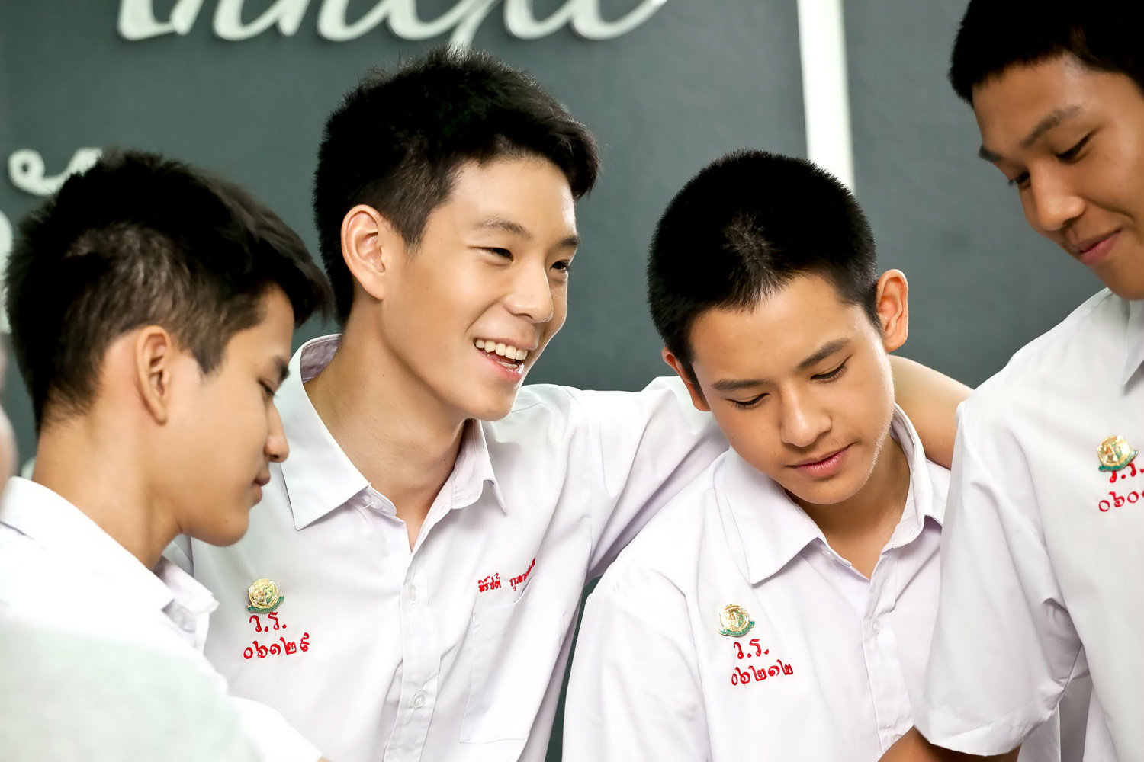
Countable nouns
student
lion
coconut
horse
book
computer
home

Slide 3
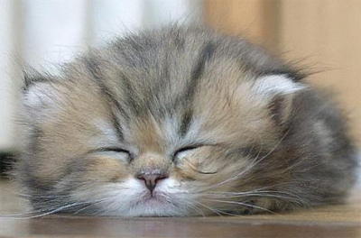
Uncountable nouns
tea
blood
iron
sugar
sleeping
traffic
weather

Slide 4
This Quiz have 5 words.
teacher
answer = countable
water
answer = uncountable
swimming
answer = uncountable
monkey
answer = countable
equipment
answer = uncountable

