Slide 1
PHP
7host.com
- Service PHP
- Clip thainame.net
http://www.youtube.com/watch?v=8fJIT468XOU
- Clip 7host.com
http://www.youtube.com/watch?v=Kl_37RTmZRo
http://www.thaiall.com/php5/7host
Update : August 23,2012
Notes:
Reference : http://www.thaiall.com/php/training49.htm

Slide 2

01 open 7host.com
.

Slide 3
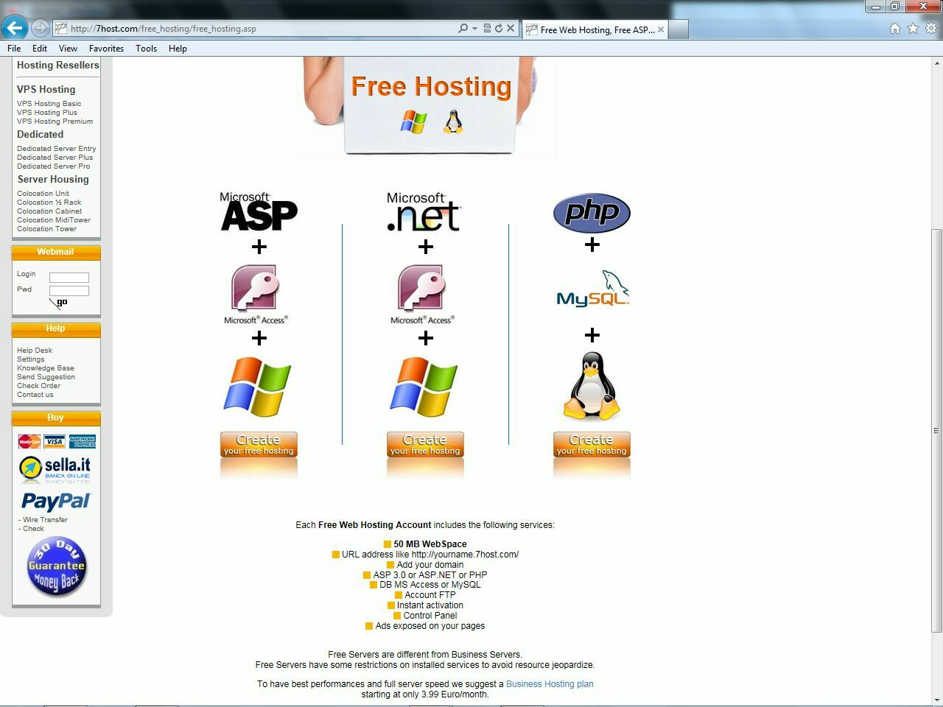
02 click free hosting

Slide 4
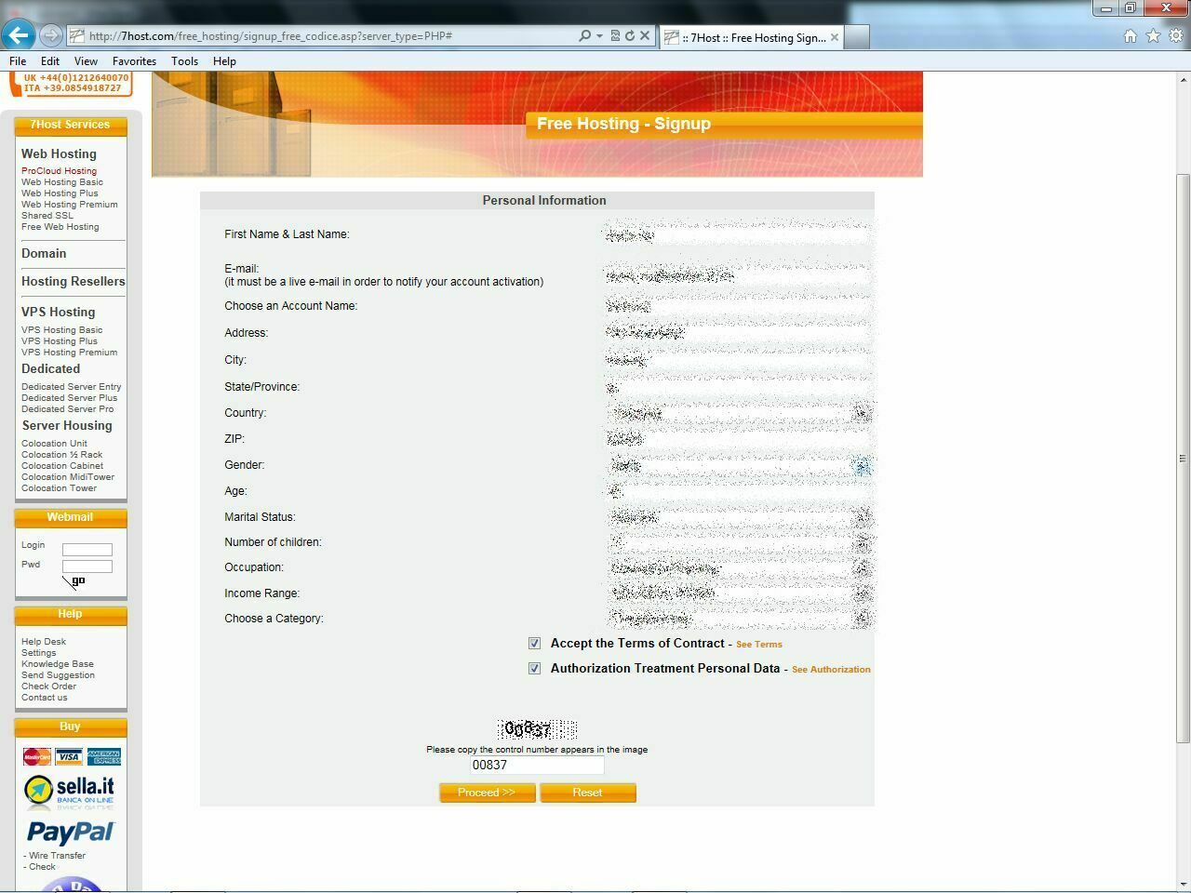
03 click php

Slide 5
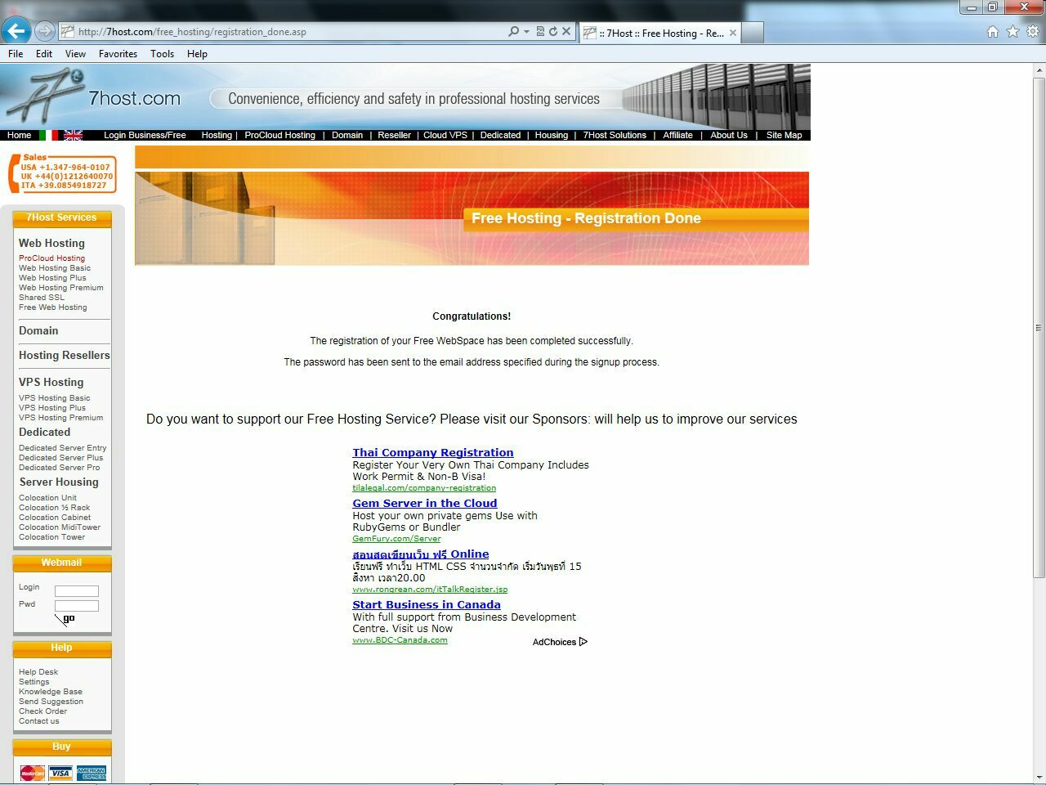
04 congratulation

Slide 6
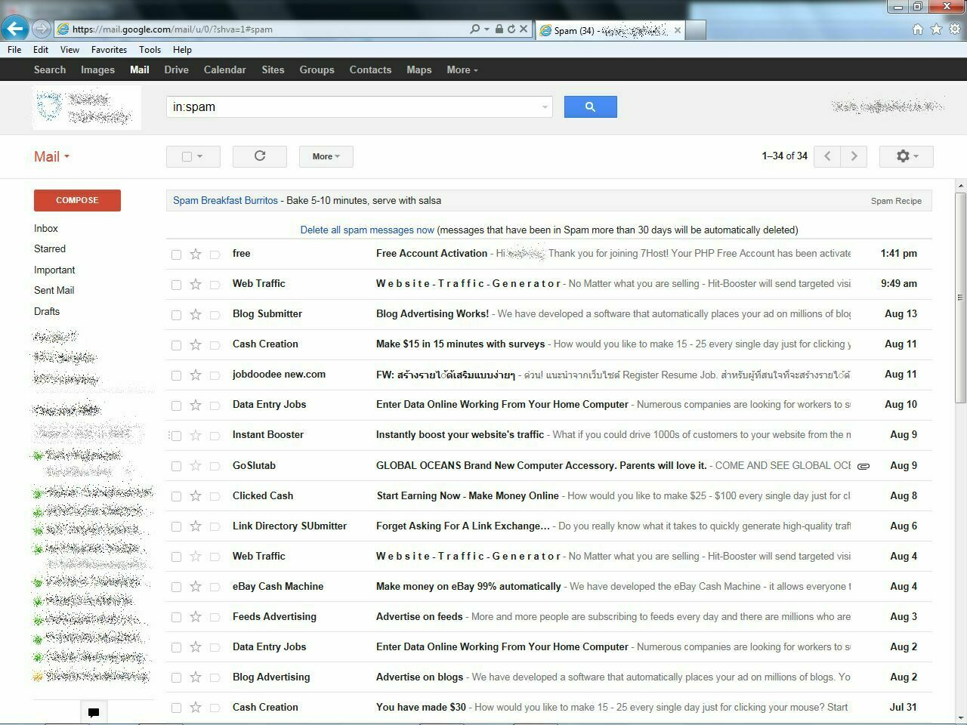
05 in spam folder
.

Slide 7
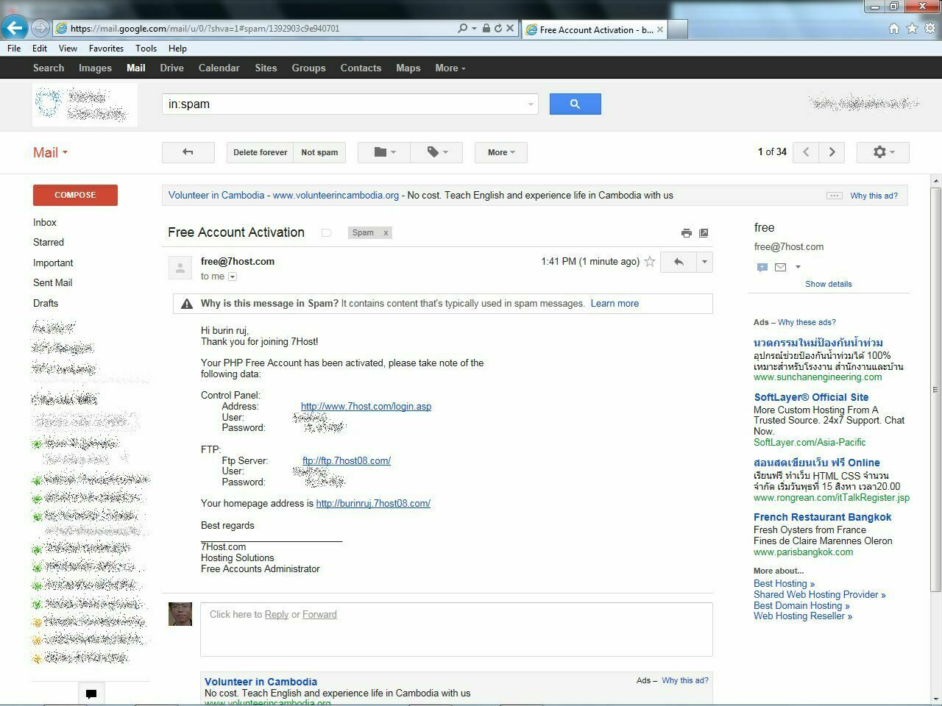
06 got password
.

Slide 8
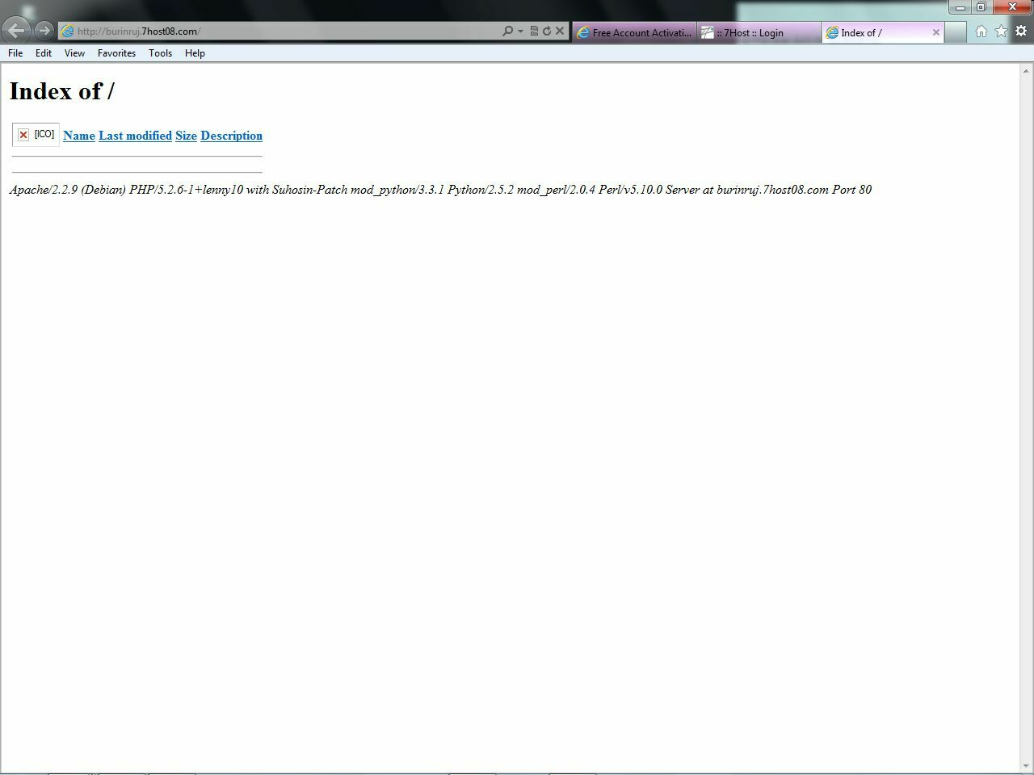
07 my homepage

Slide 9
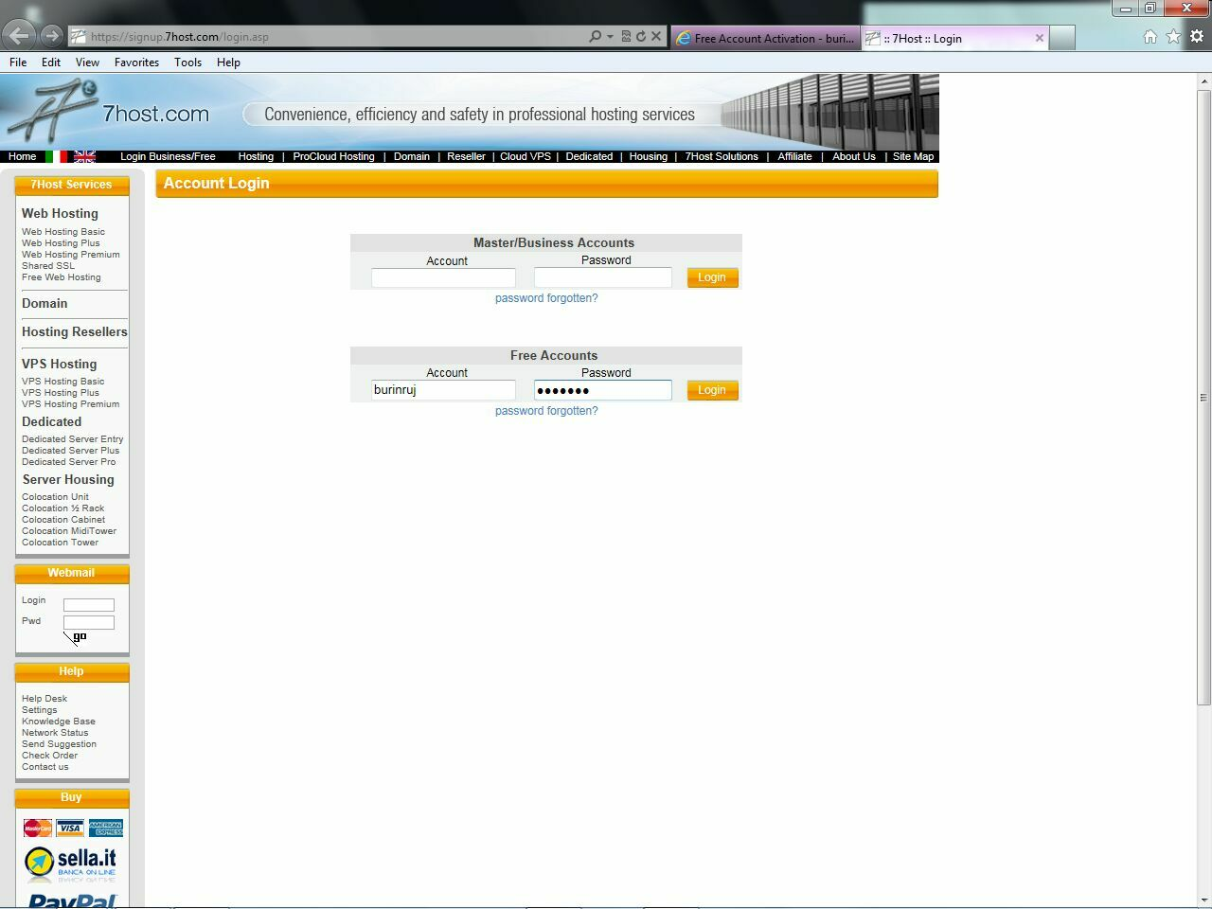
08 login page

Slide 10
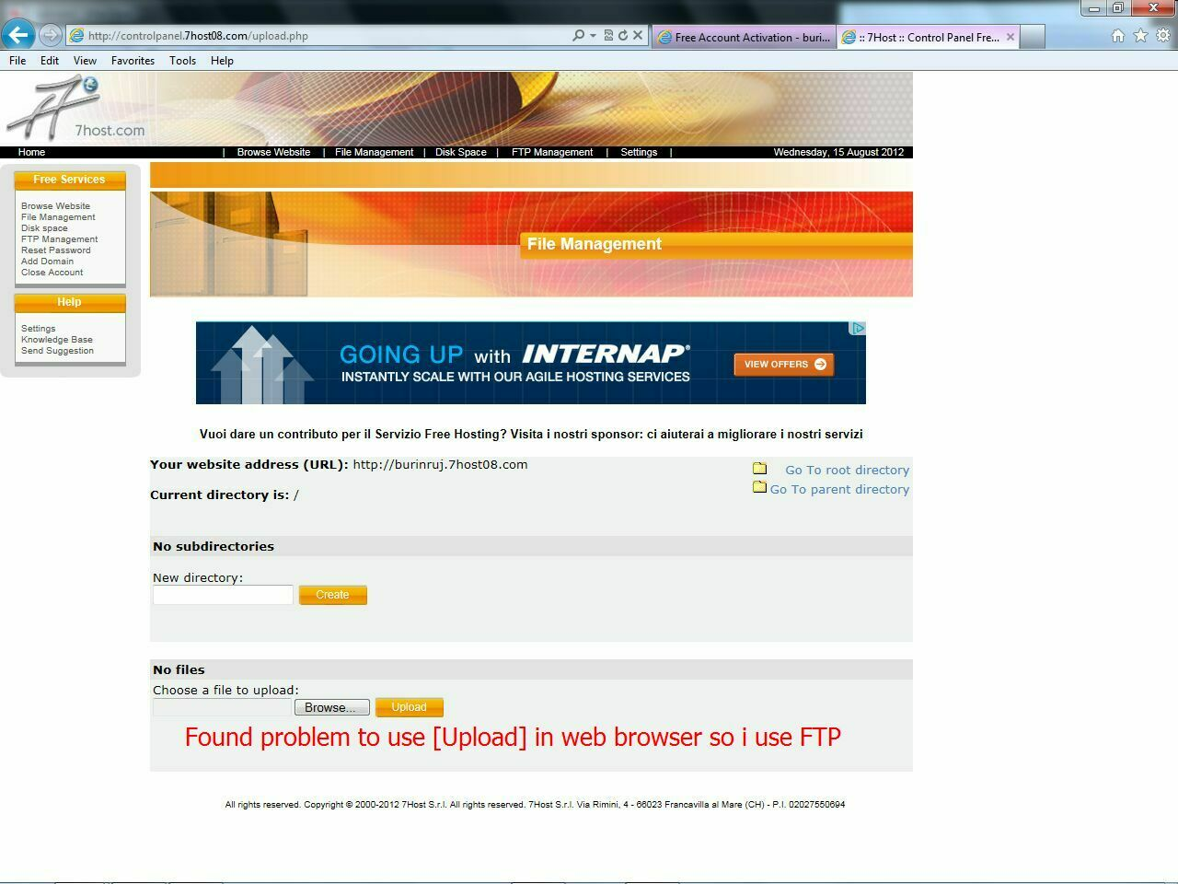
09 login pass

Slide 11
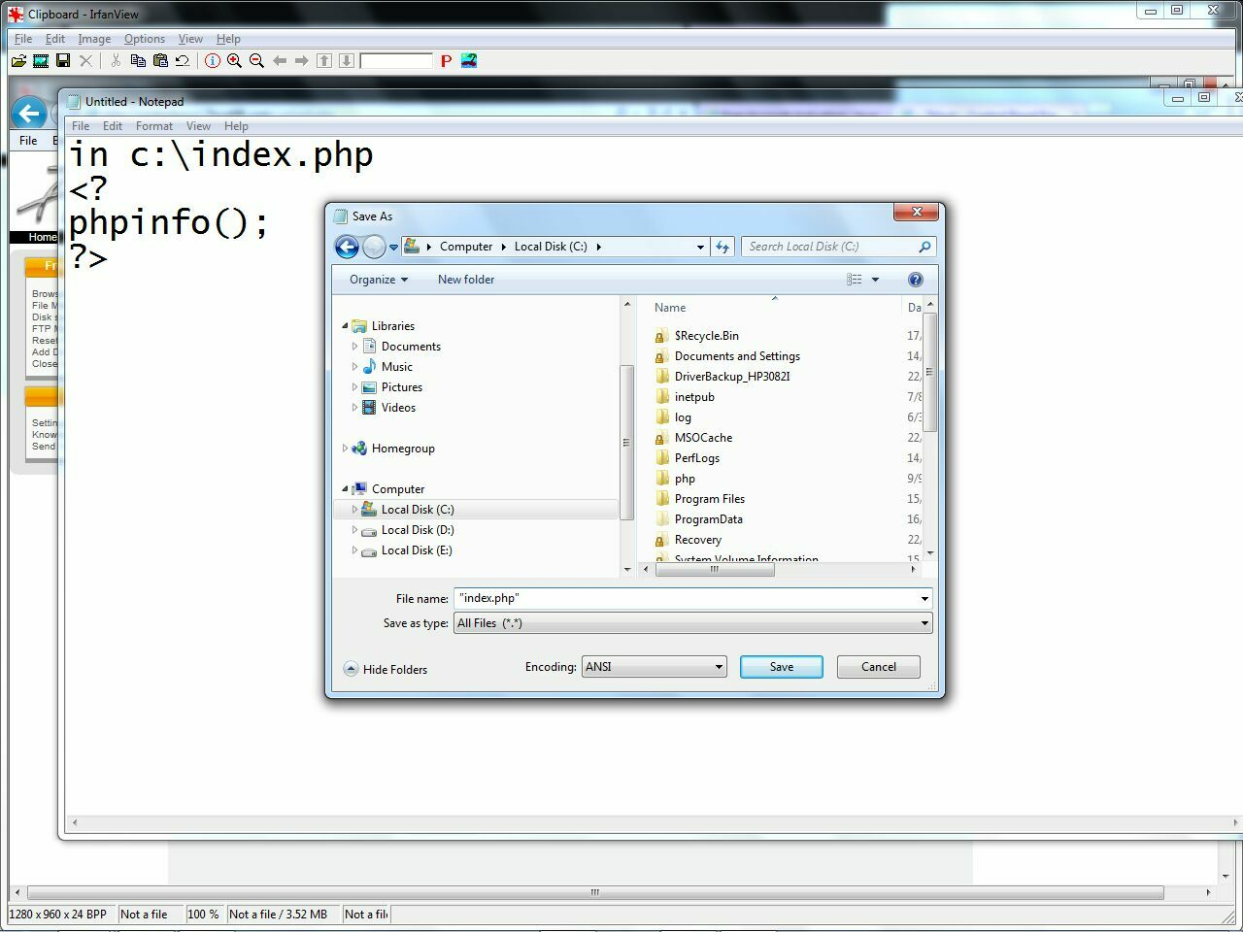
10 index.php
.

Slide 12
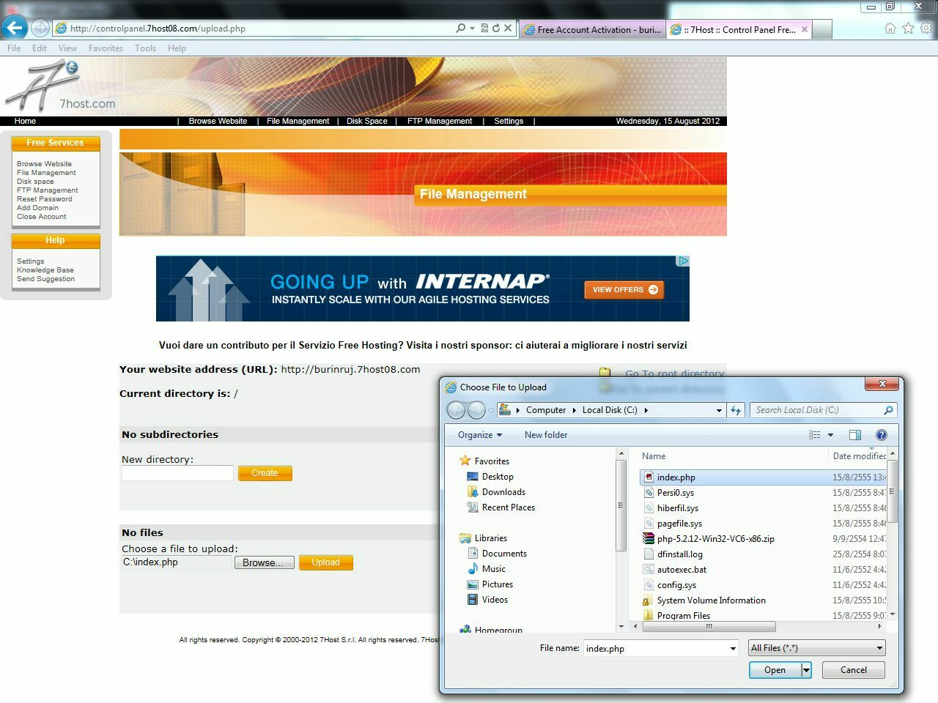
11 select file

Slide 13
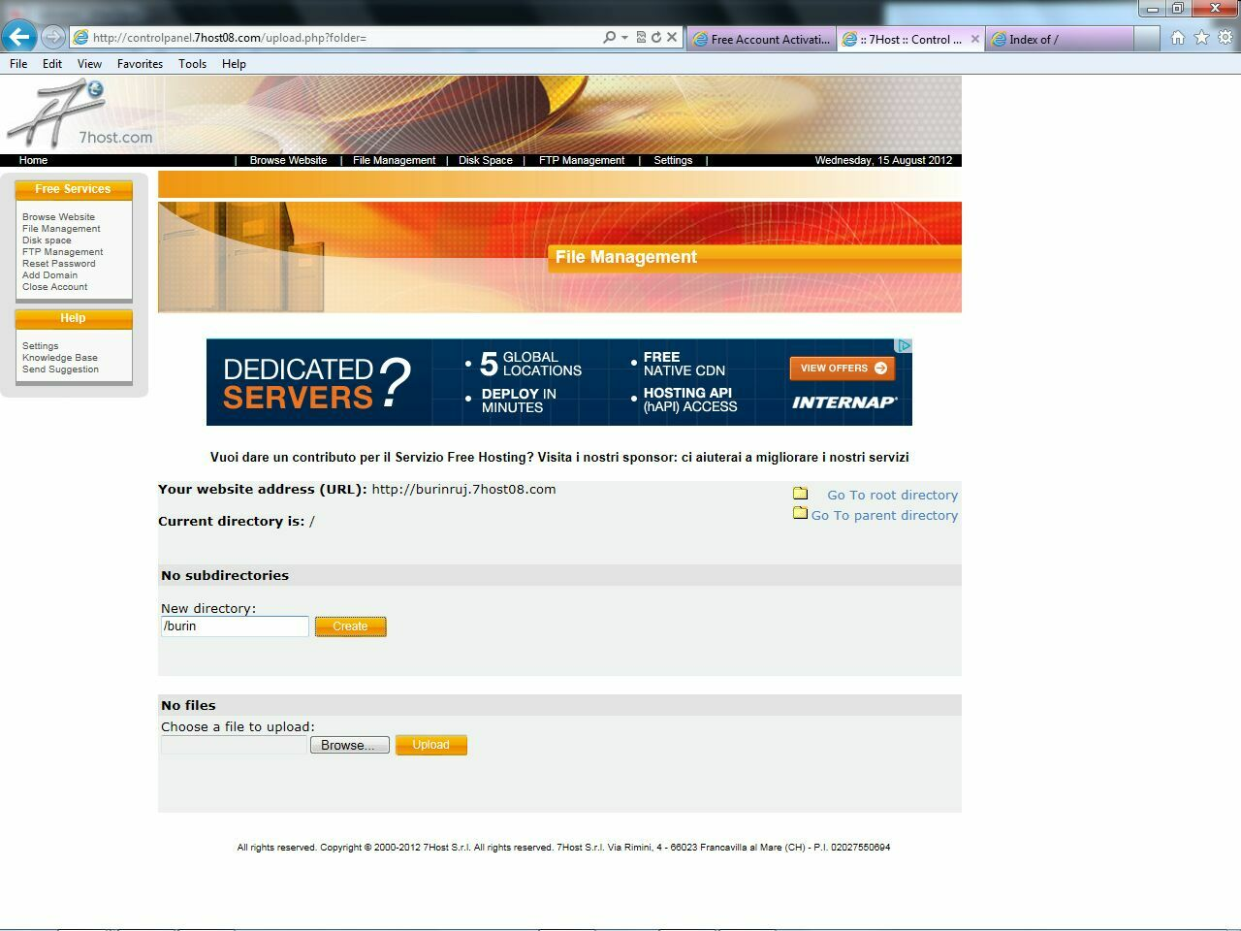
12 create dir

Slide 14
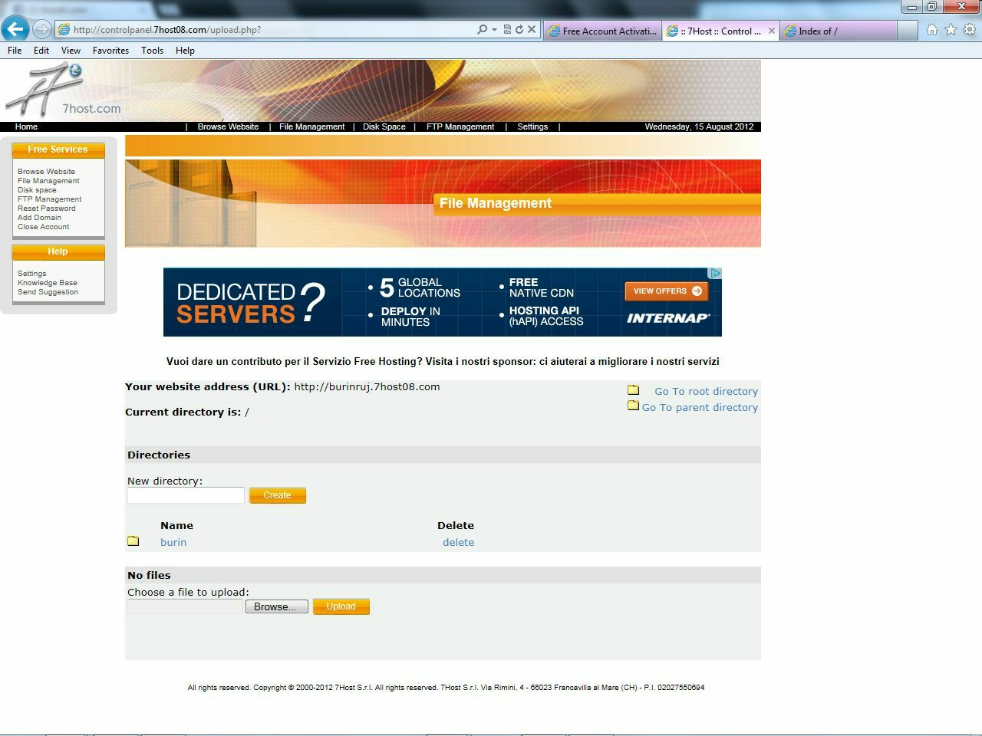
13 have dir

Slide 15
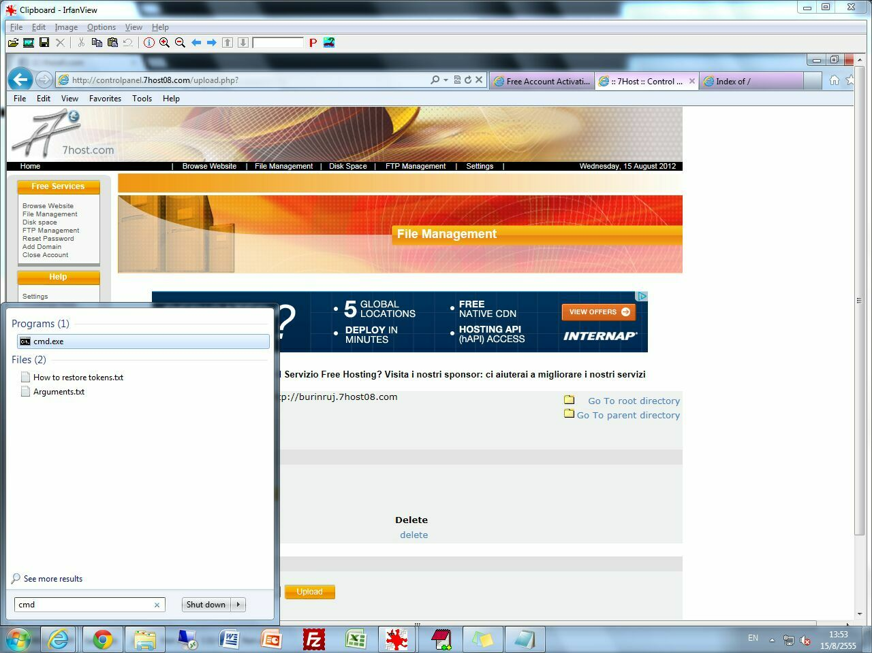
14 cmd
.

Slide 16
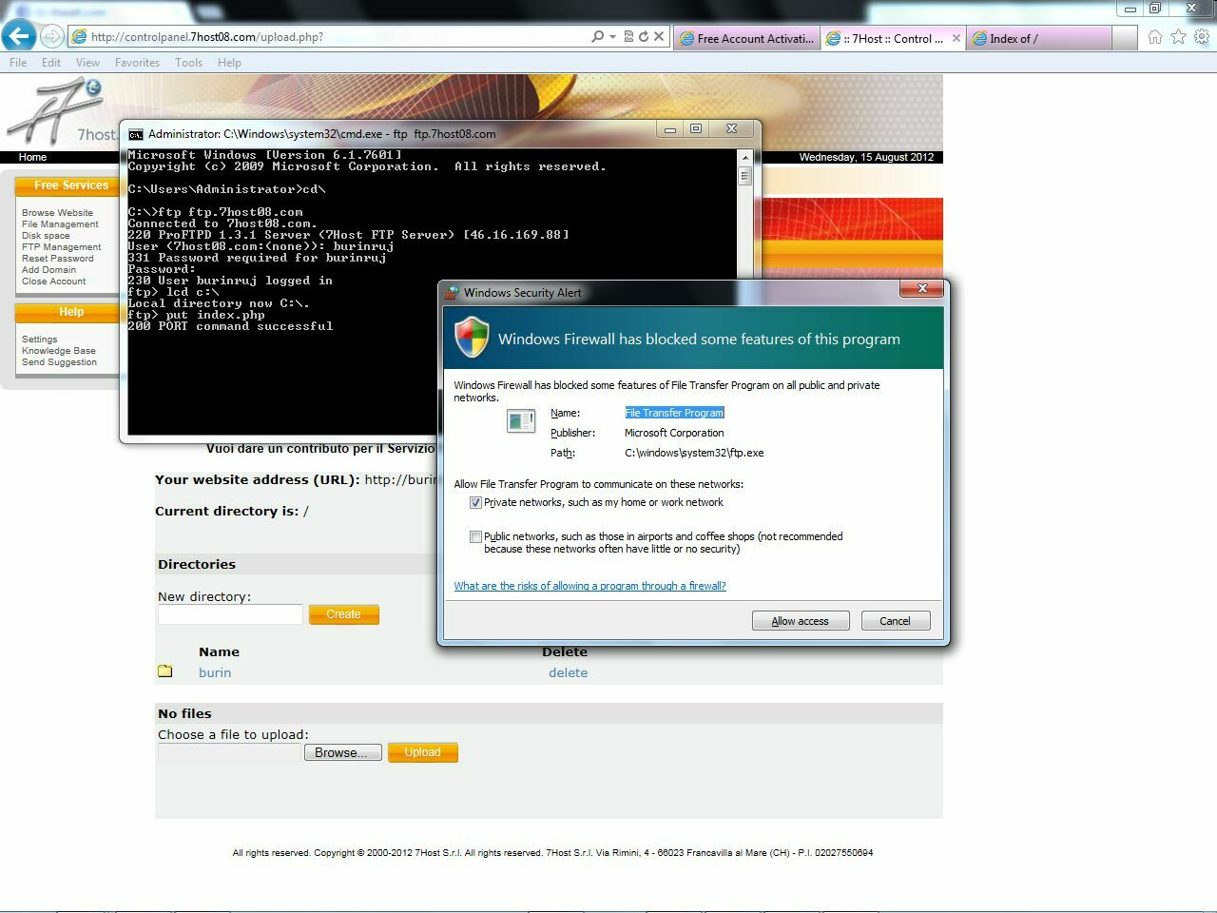
15 put file

Slide 17
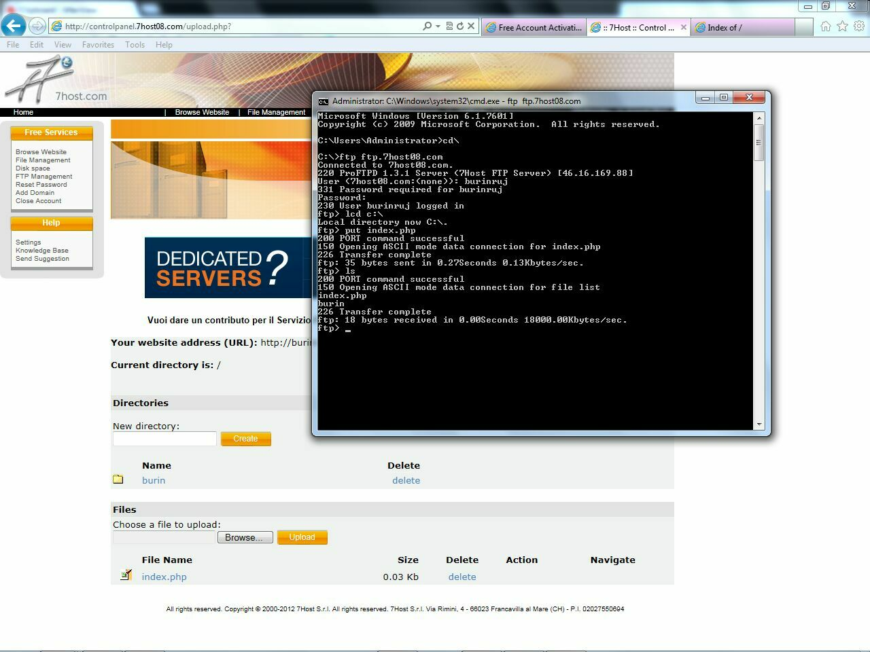
16 have file

Slide 18
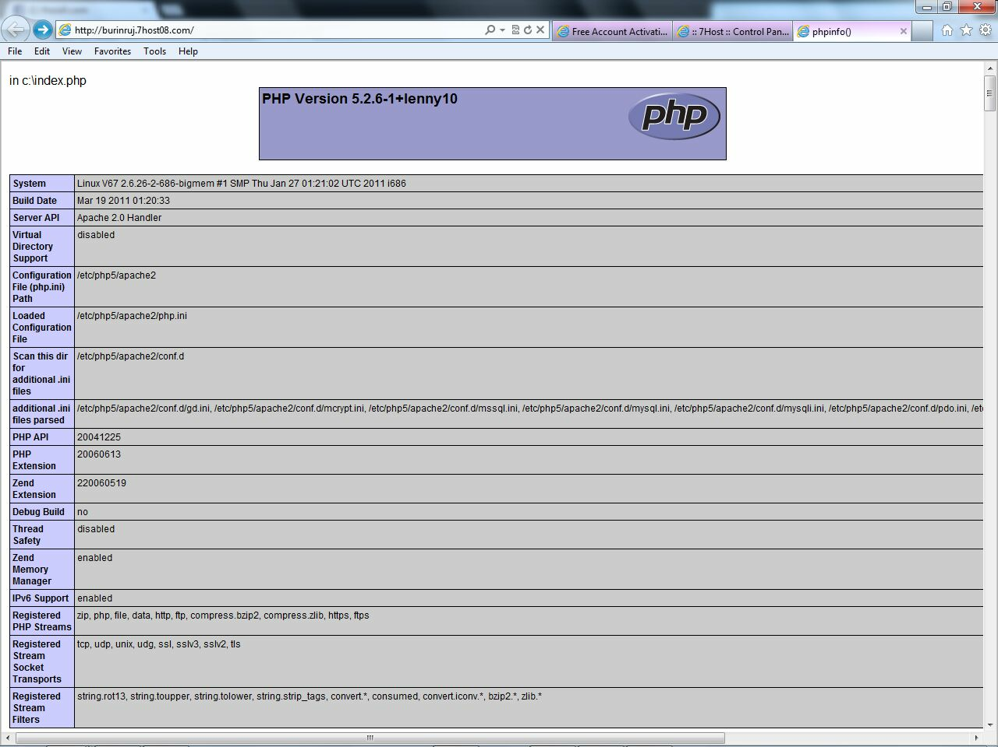
17 home

Slide 19
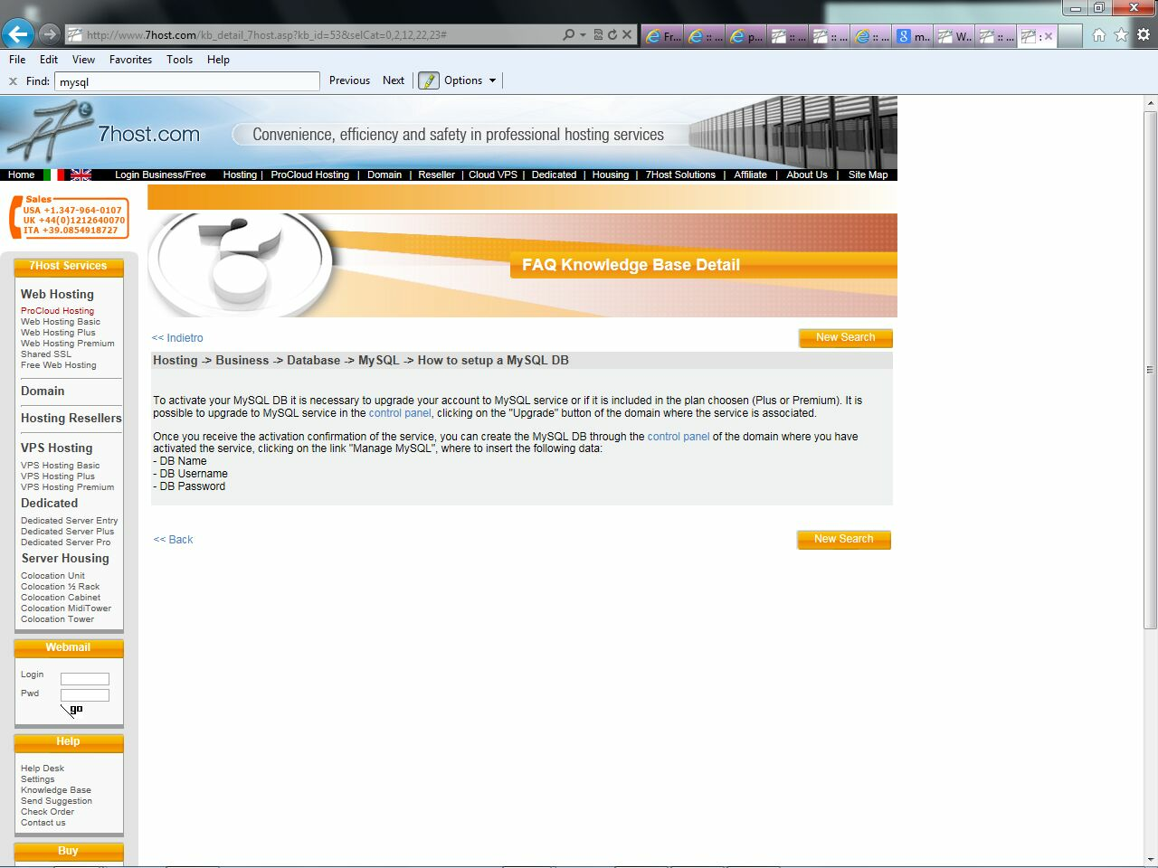
18 upgrade mysql

