Slide 1
PHP
http://www.thaiall.com/source/
http://www.thaiall.com/perlphpasp/source.htm
Update : August 23,2012
Notes:
Reference : http://www.thaiall.com/php/training49.htm

Slide 2
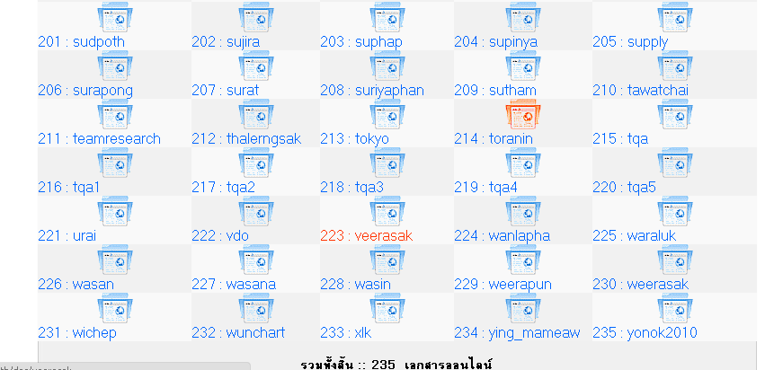
Managefile.php
Used in my university
http://www.thaiall.com/perlphpasp/source.pl?key=9102

Slide 3
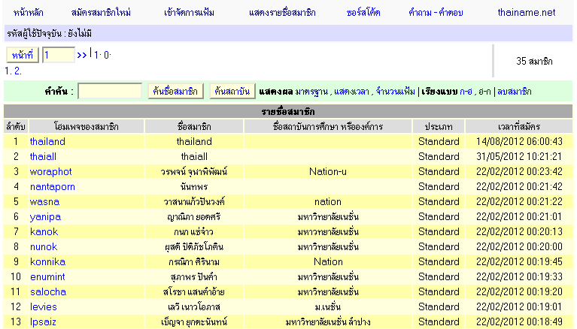
Filemanager.php
http://www.thainame.net/home/
http://www.thaiall.com/perlphpasp/source.pl?key=9108
Password : I love thailand.

Slide 4
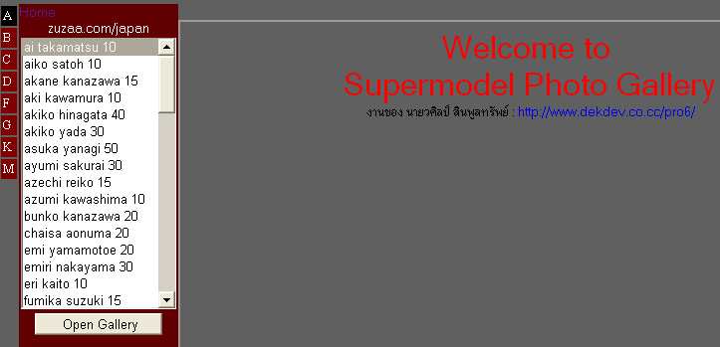
Supermodel.php
http://www.thaiall.com/actress
http://www.thaiall.com/perlphpasp/source.pl?key=9115

Slide 5
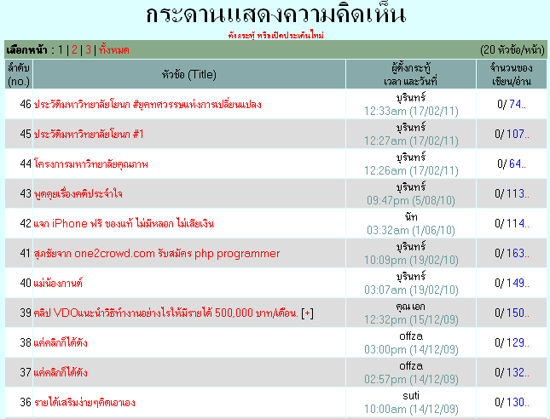
Webboard.php
http://www.thaiall.com/opinion
http://www.thaiall.com/perlphpasp/source.pl?key=9119

Slide 6
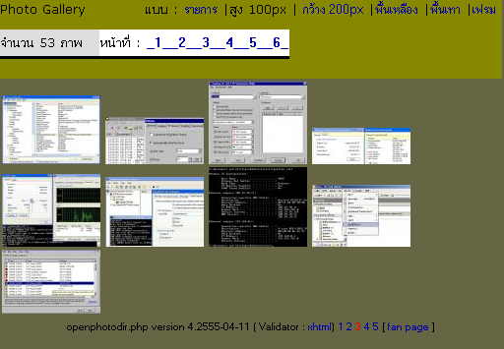
Openphotodir.php
http://www.thaiall.com/pptx
http://www.thaiall.com/perlphpasp/source.pl?key=9130

Slide 7
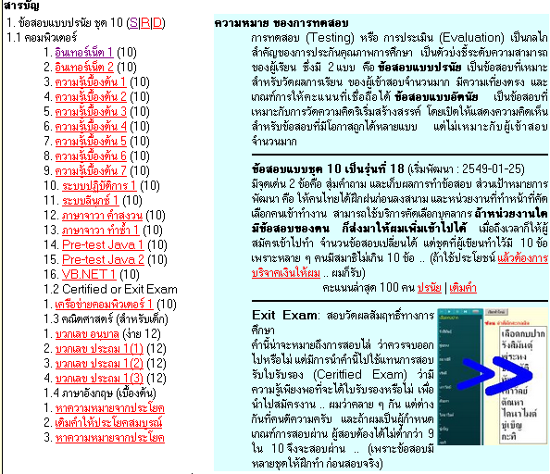
Mini online quiz on MySQL
http://www.thaiall.com/quiz
http://www.thaiall.com/perlphpasp/source.pl?key=9113

Slide 8
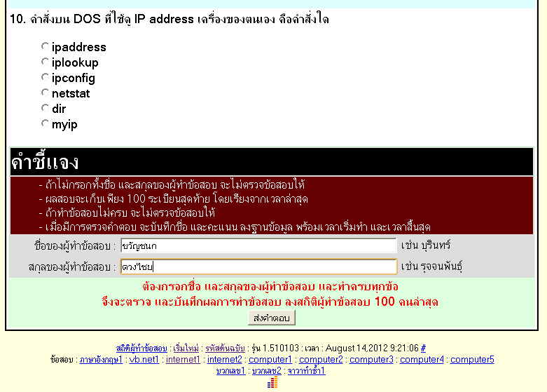
แบบทดสอบออนไลน์ (Online Testing)
http://www.thaiall.com/quiz/test10.php?subj=internet1

Slide 9
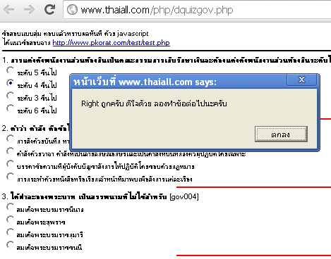
Online Quiz
http://www.thaiall.com/php/dquiz.htm

Slide 10
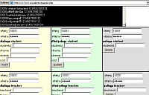
ระบบรายงานผลการเรียน
http://www.thaiall.com/students/

Slide 11
Manage MySQL in one file.
http://www.thaiall.com/perlphpasp/source.pl?key=9137

Slide 12
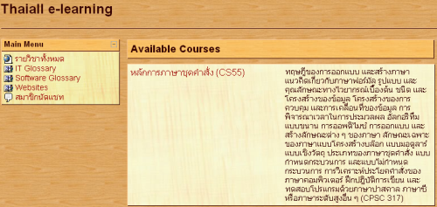
E-learning
http://www.thaiall.com/moodle

Slide 13
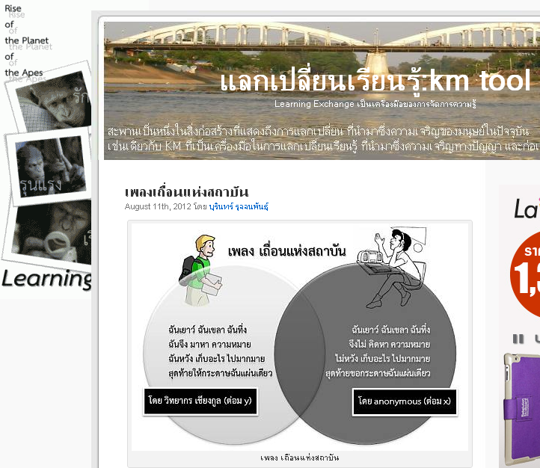
Blog
http://www.thaiall.com/blog
http://www.wordpress.com

