Slide 1
PHP
freewebhostingarea.com
- Service free webhosting
- Ueuo is one of many server
- MySQL
- PHP
- Linux Server
- Automatic Unzip
http://www.freewebhostingarea.com
http://thaiabc.ueuo.com
http://www.thaiall.com/php5/ueuo
Updated : August 23,2012
Notes:
Reference : http://www.thaiall.com/php/training49.htm

Slide 2
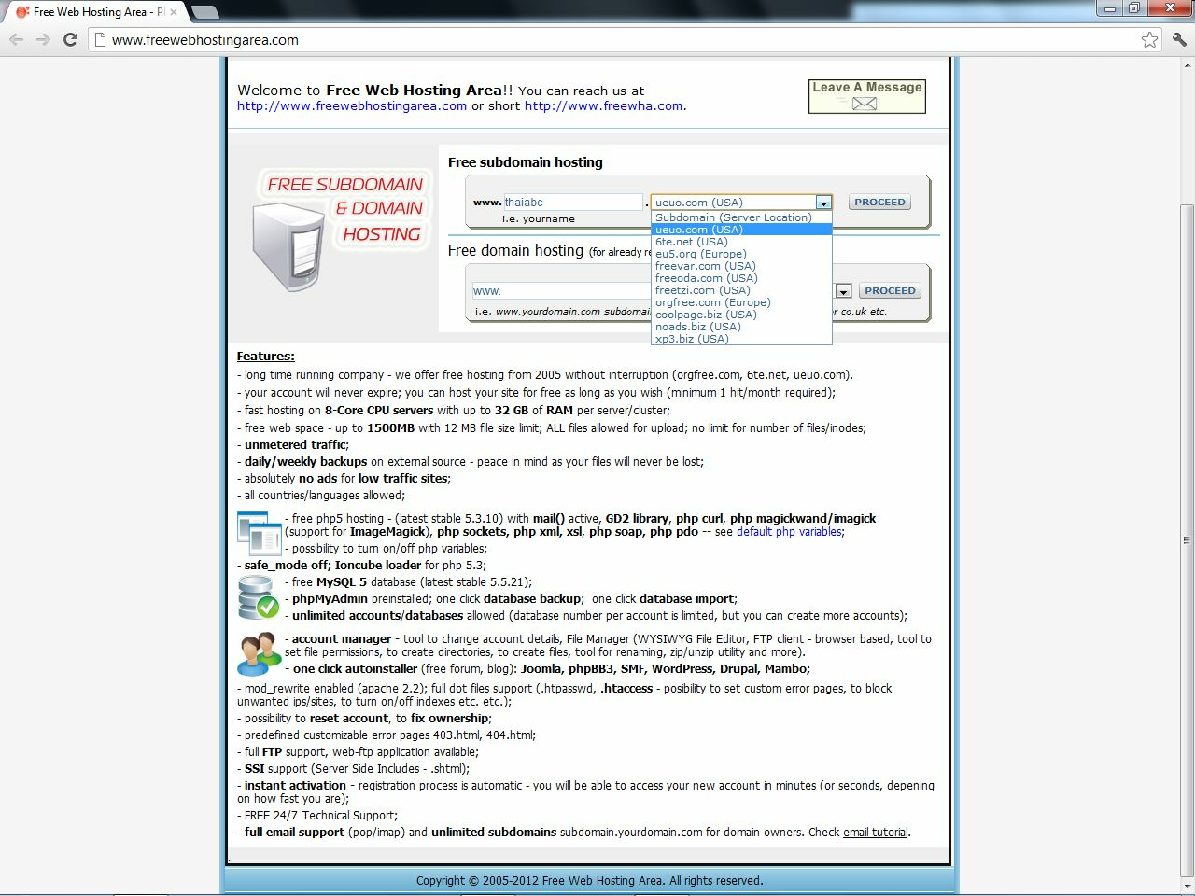
01_open_freewebhostingarea
.

Slide 3
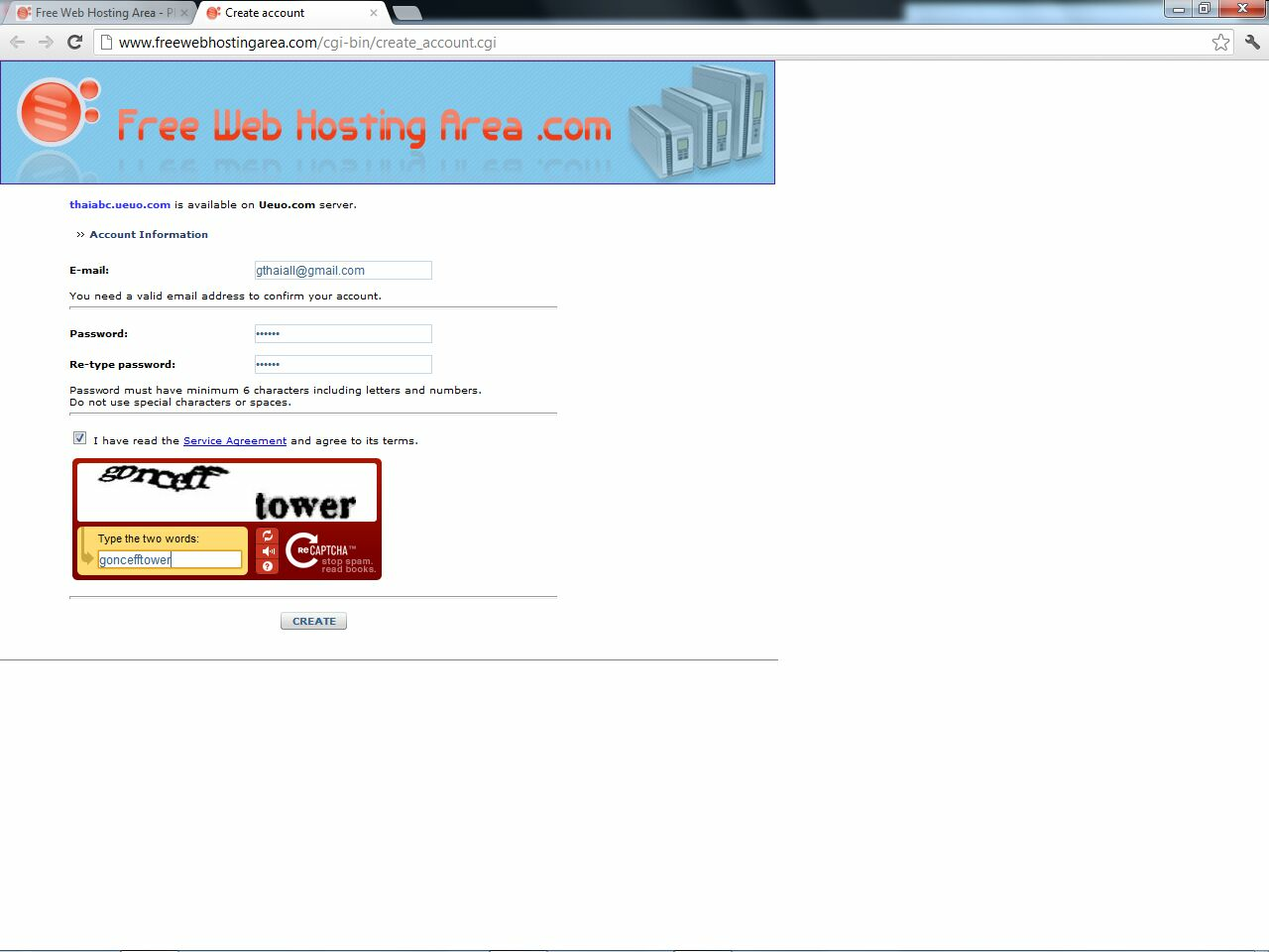
02_create_account
.

Slide 4
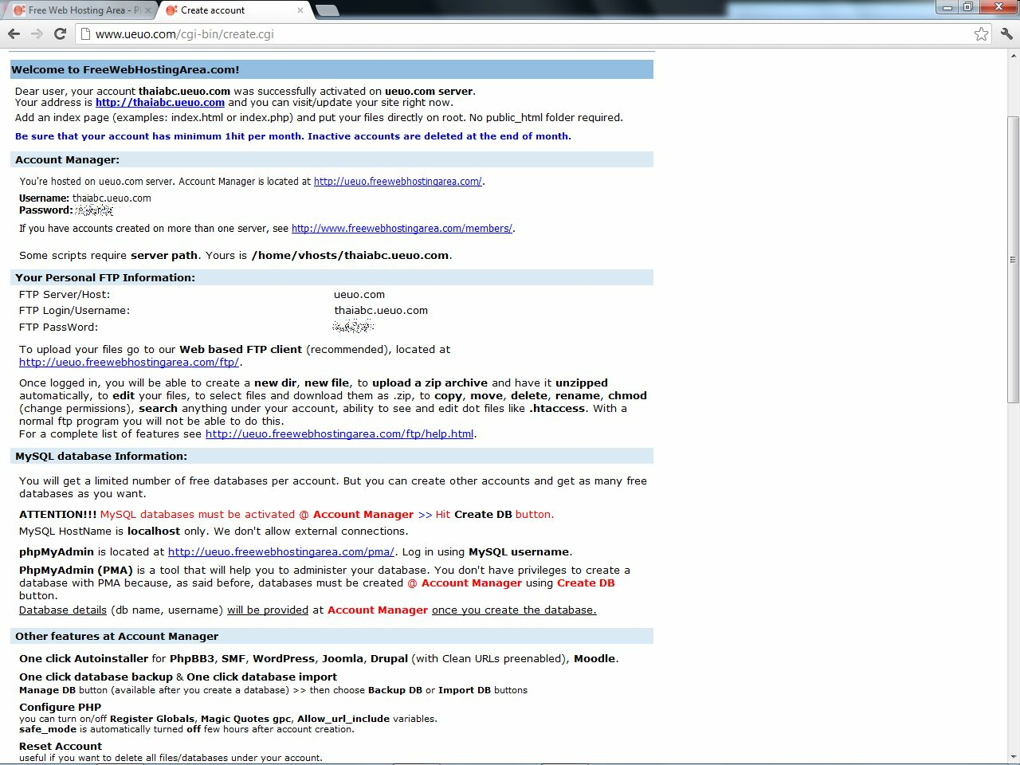
03_create
.

Slide 5
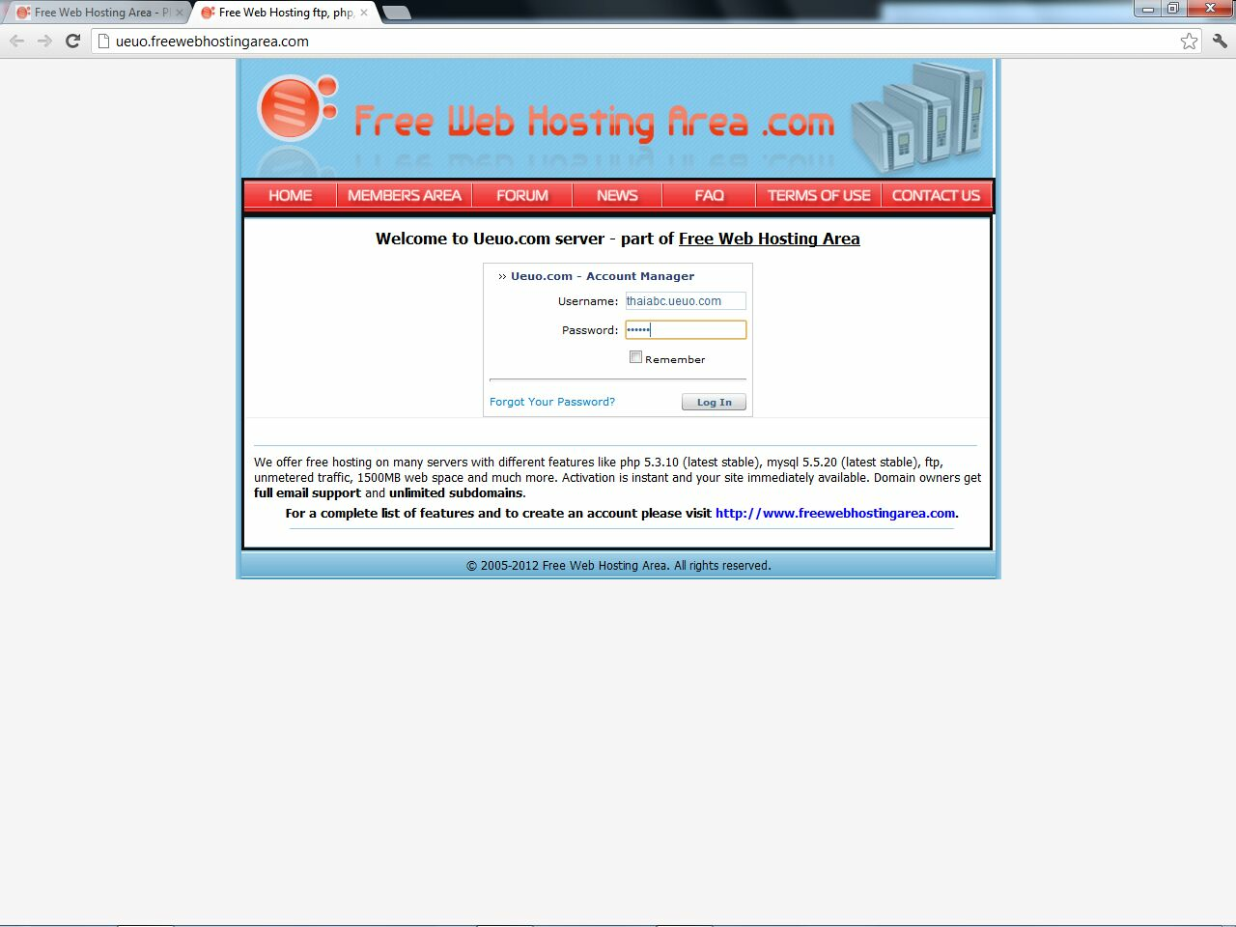
04_login_page
.

Slide 6
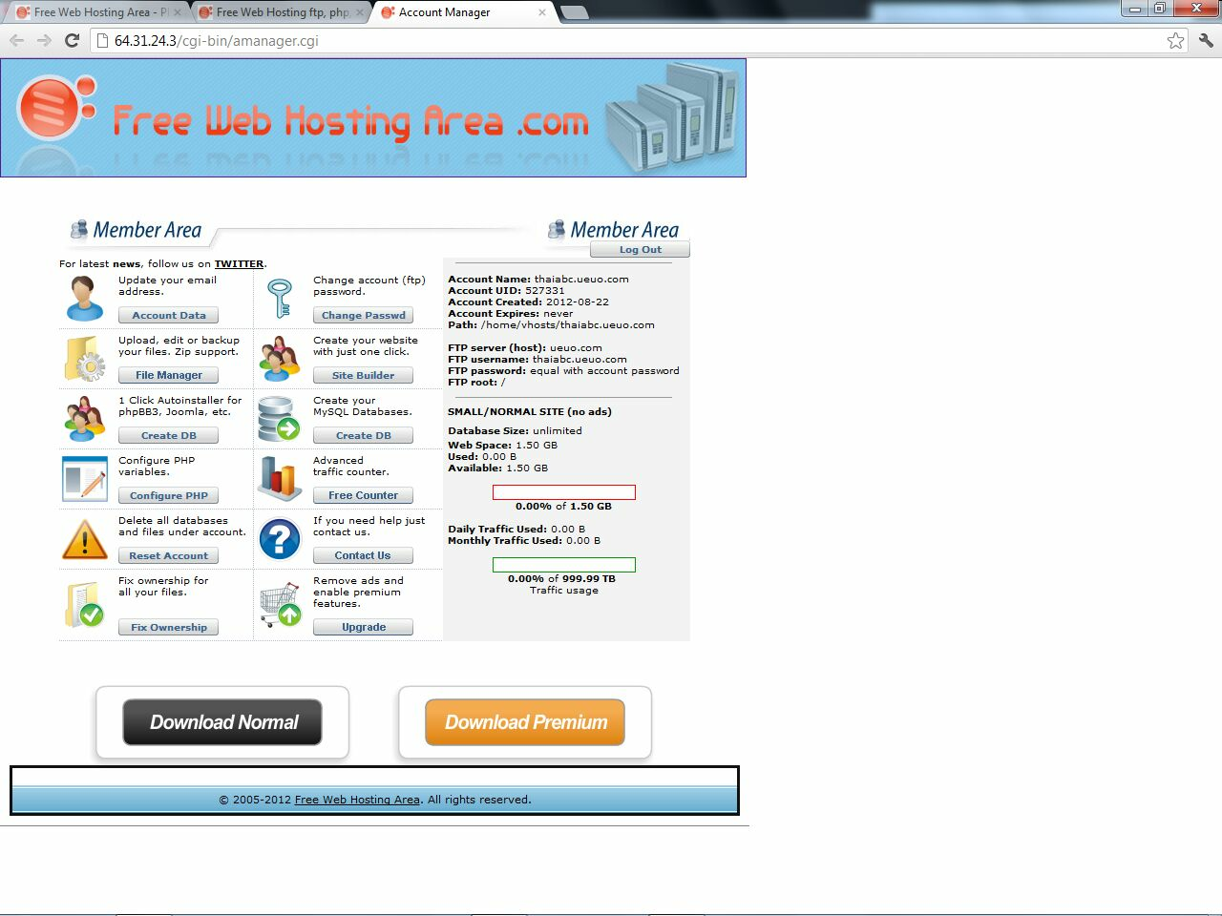
05_member_area
.

Slide 7
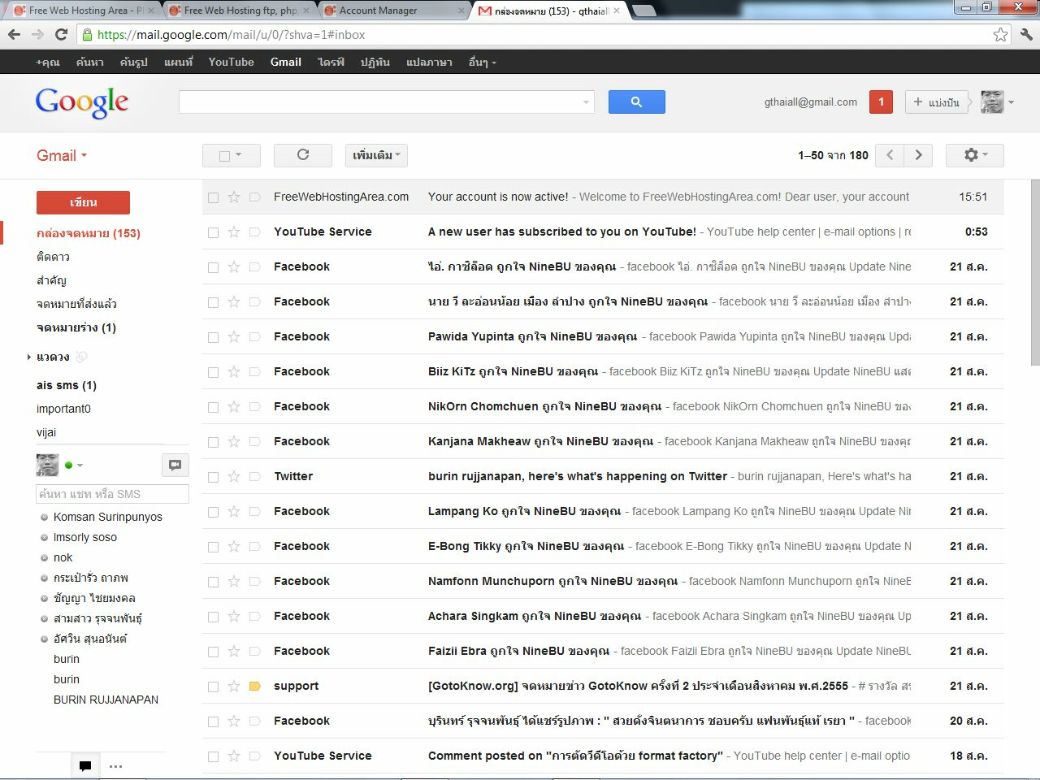
06_got_mail
.

Slide 8
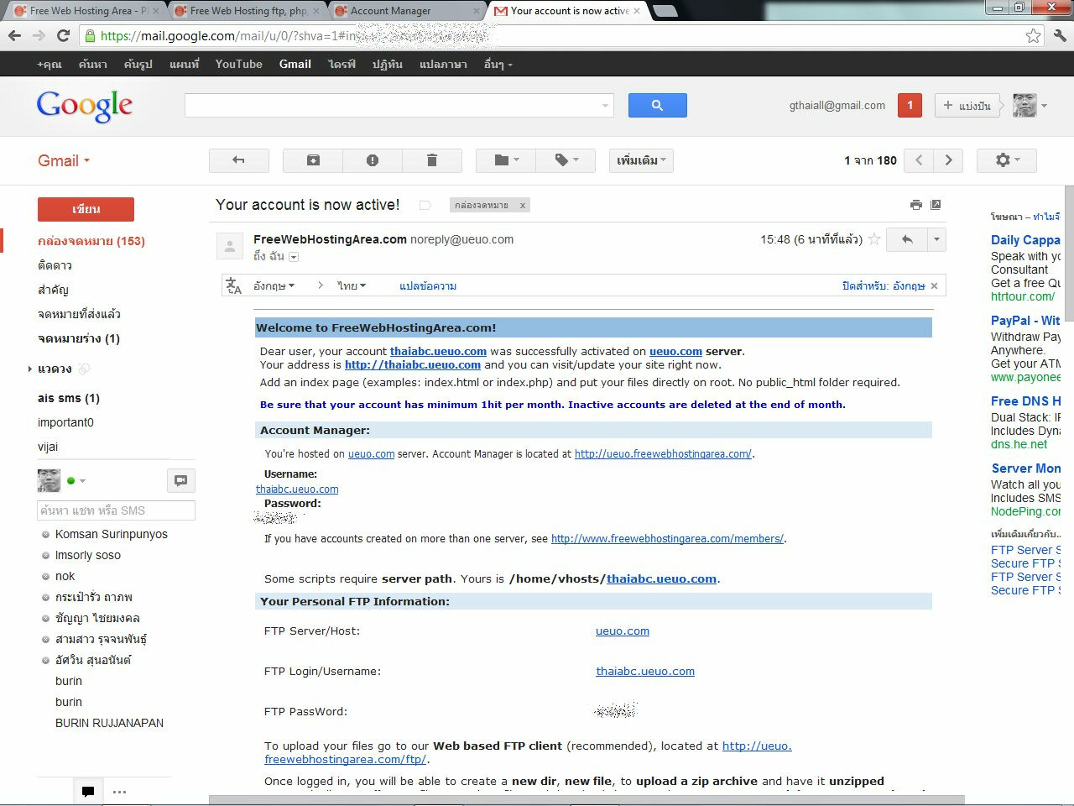
07_read_mail
.

Slide 9
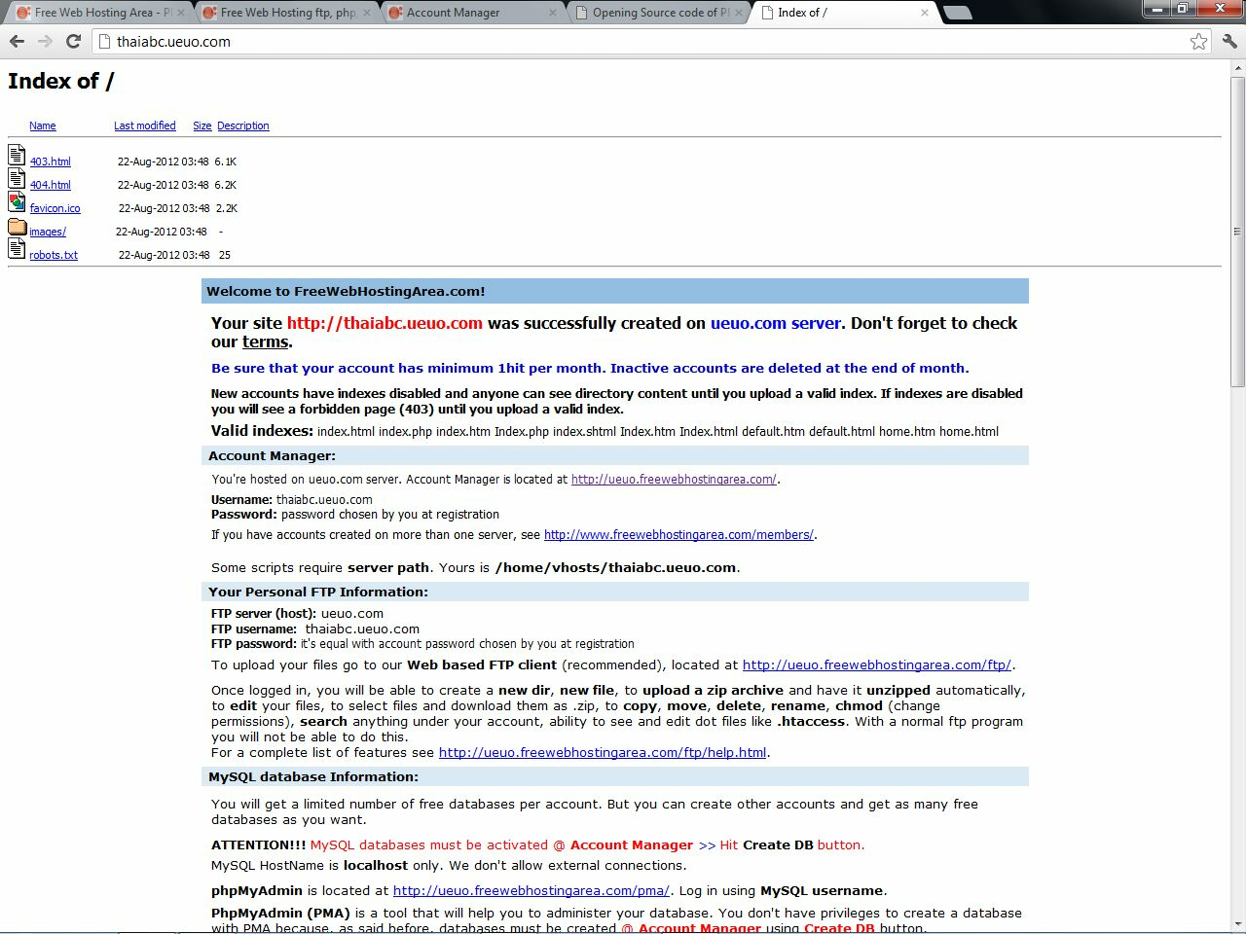
08_blank_home
.

Slide 10
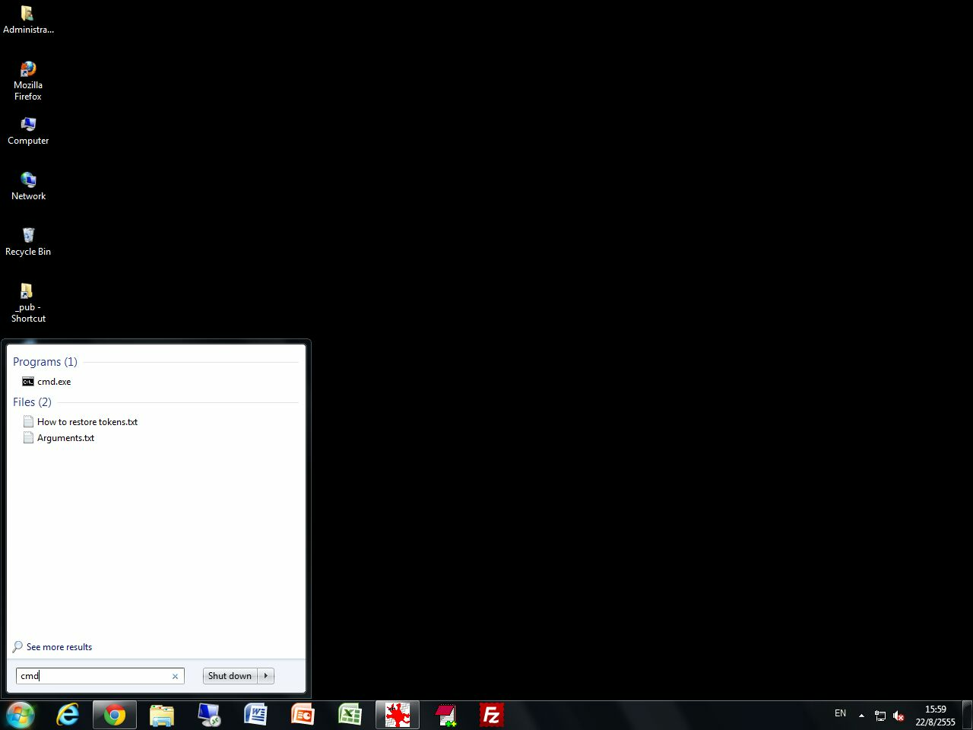
09_cmd
.

Slide 11
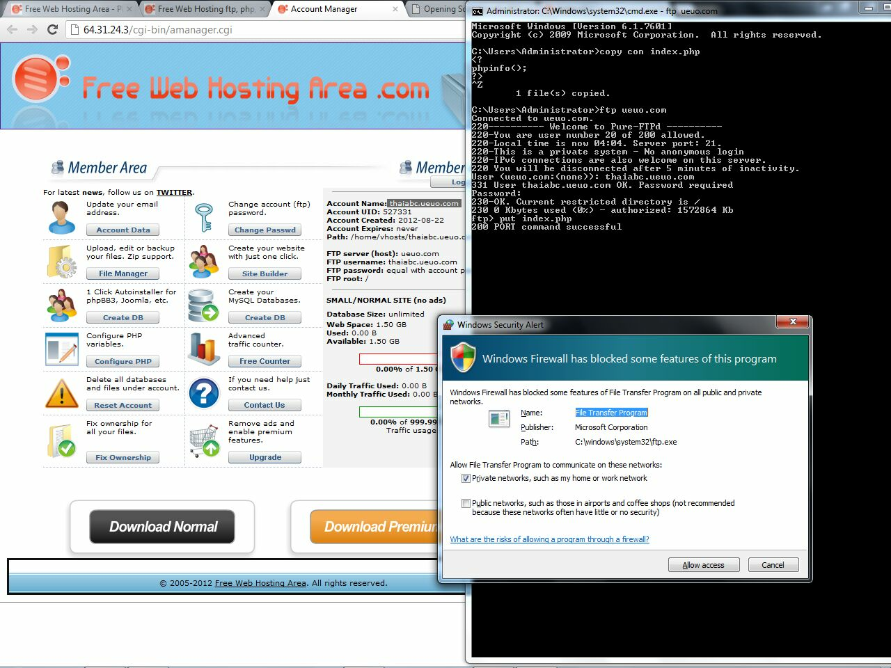
10_put_index
.

Slide 12
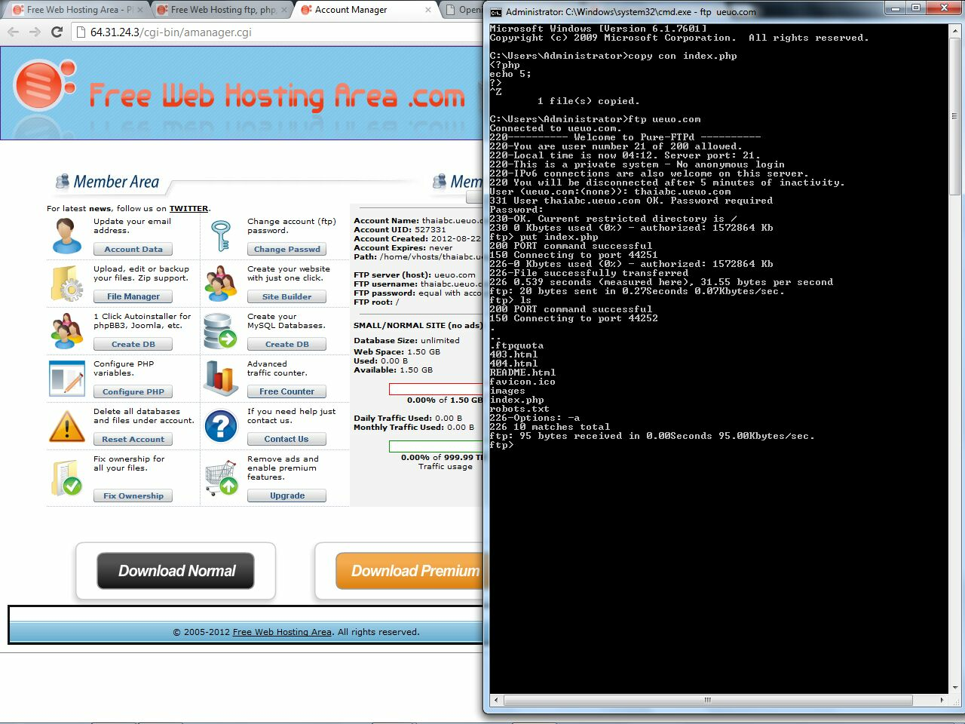
11_ls
.

Slide 13
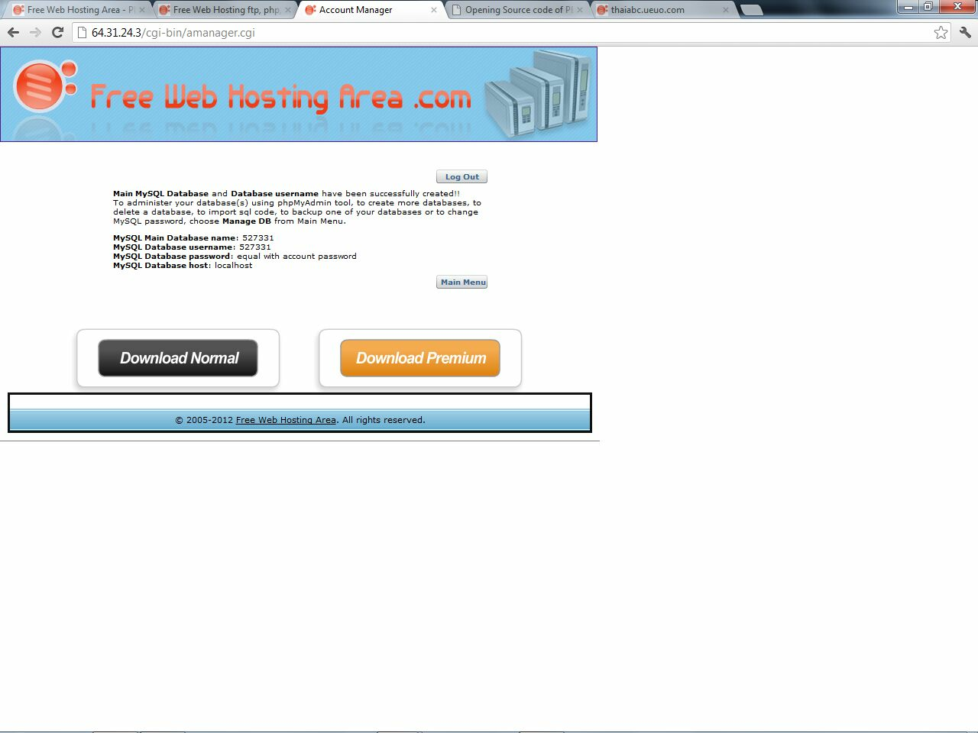
12_create_db_just_one_click
.

Slide 14
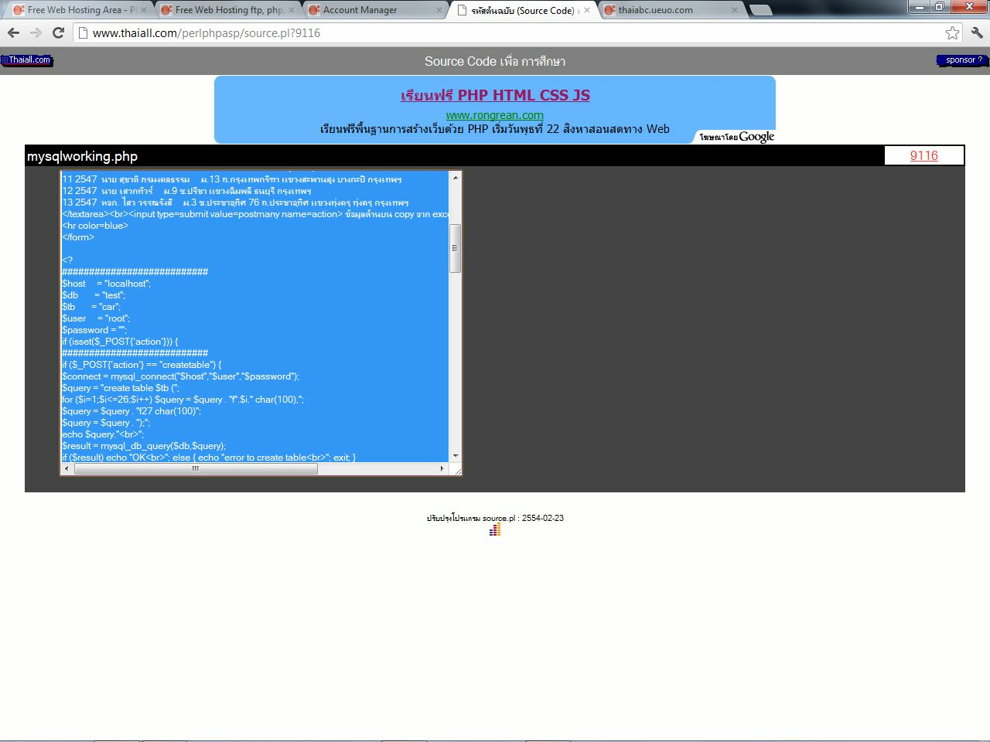
13_copy_code
.

Slide 15
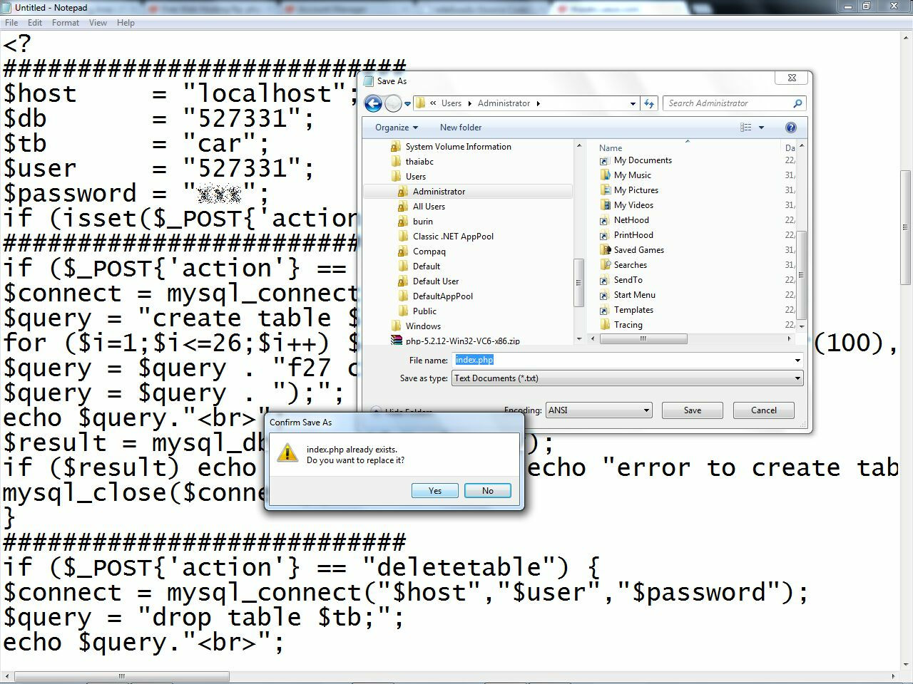
14_save_script
.

Slide 16
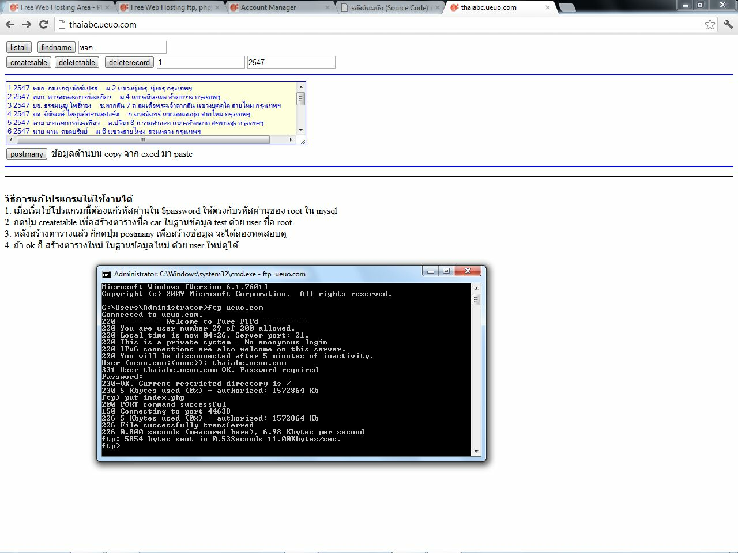
15_upload_and_home
.

Slide 17
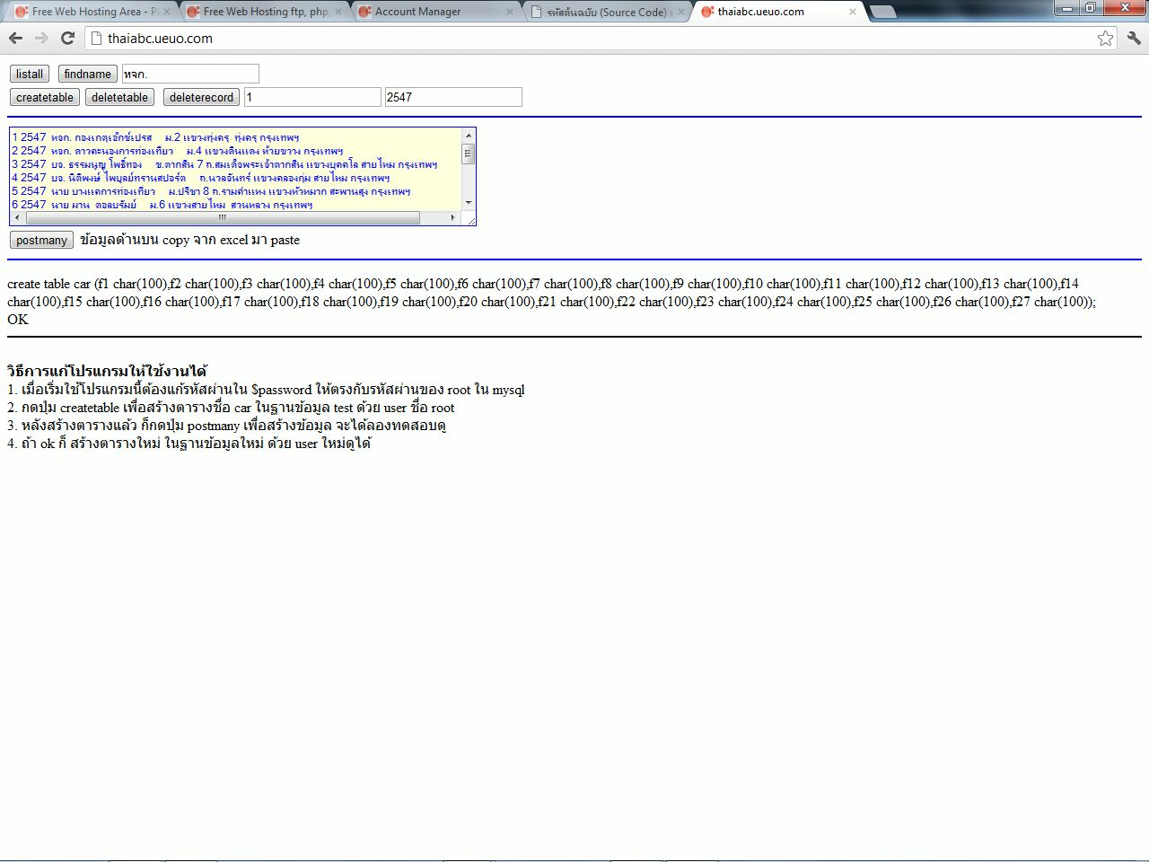
16_create_table
.

Slide 18
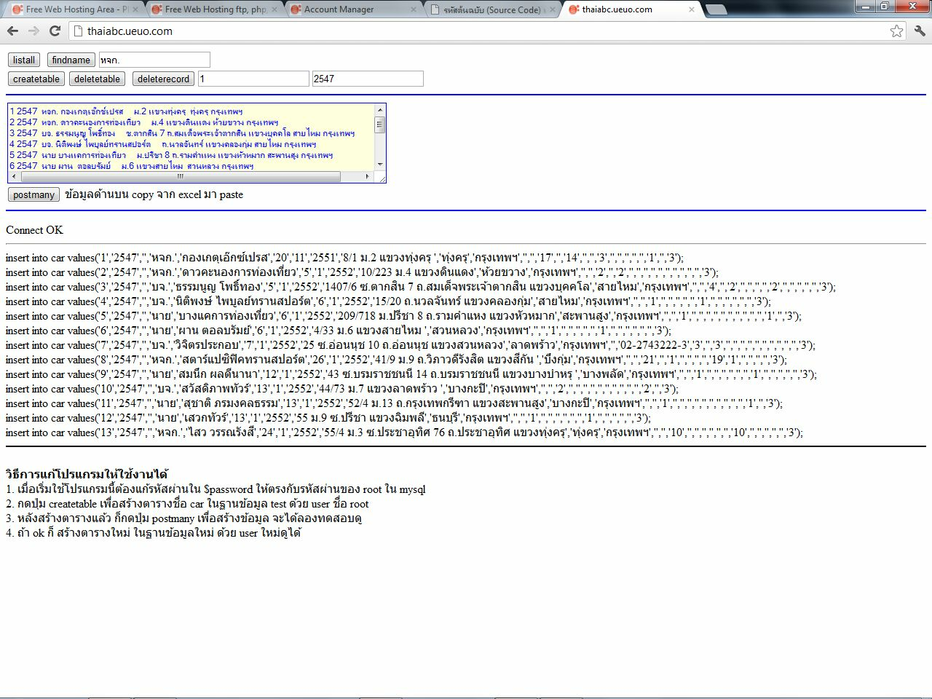
17_postmany.jpg
.

Slide 19
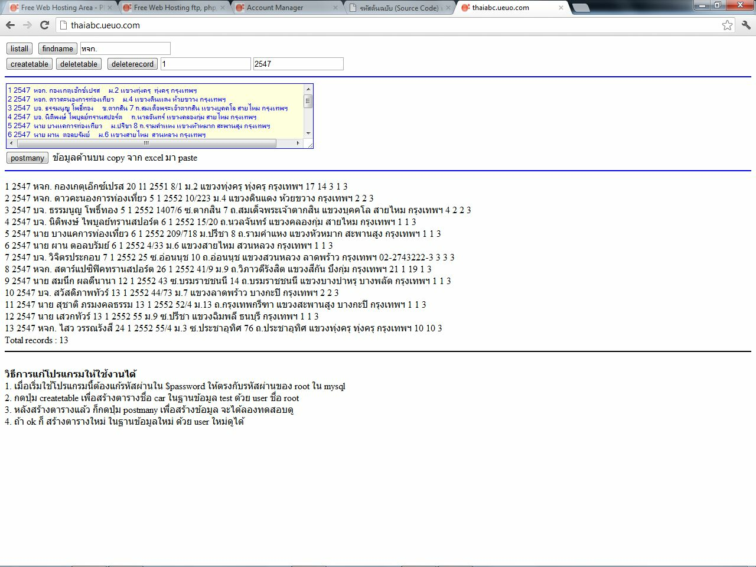
18_listall.jpg
.

Slide 20
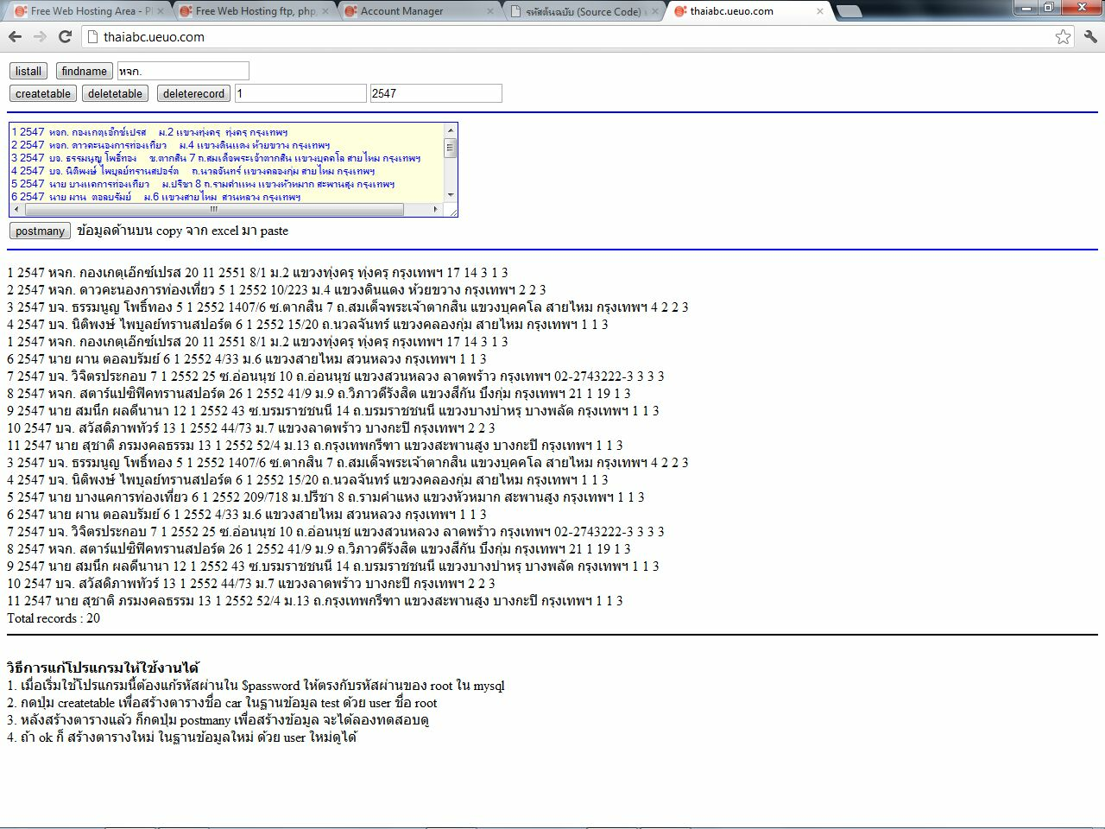
19_after_delete
.

Slide 21
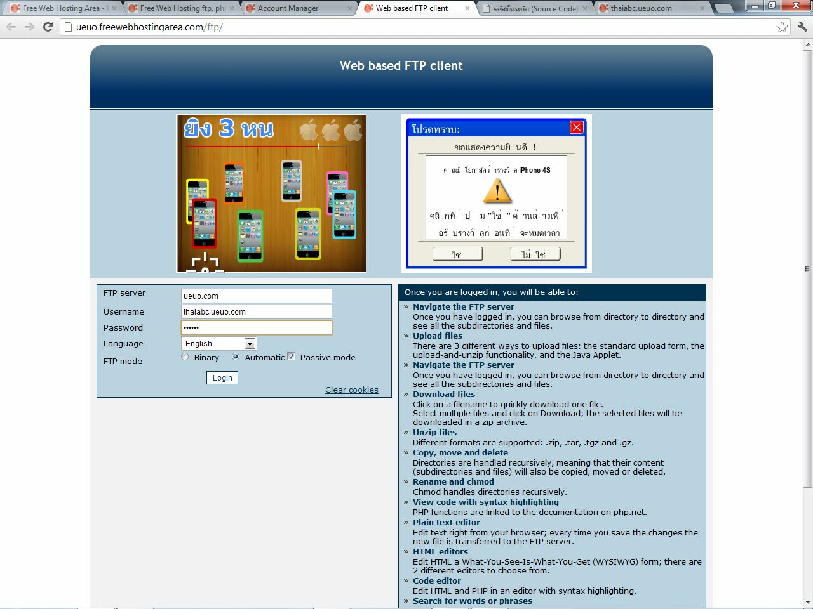
20_file_manager
.

Slide 22
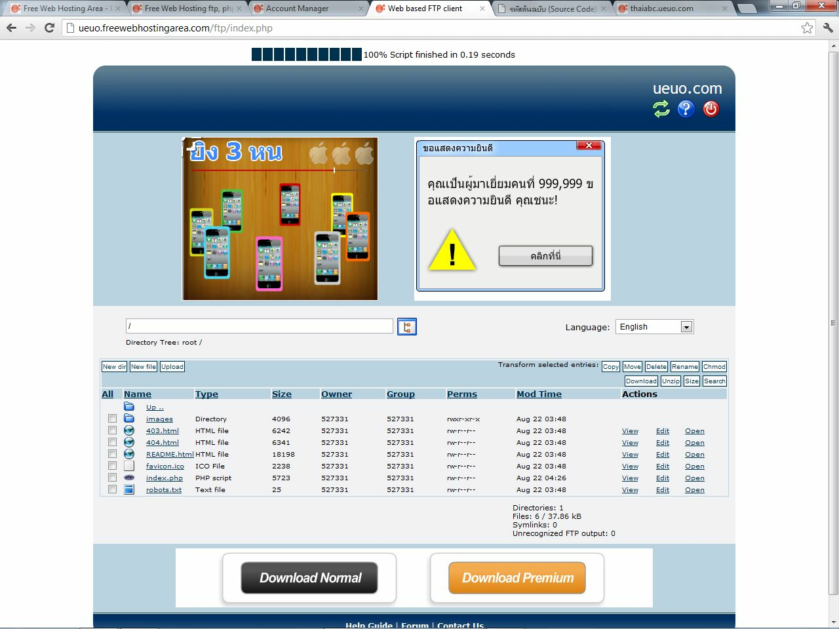
21_file_listing.jpg
.

Slide 23
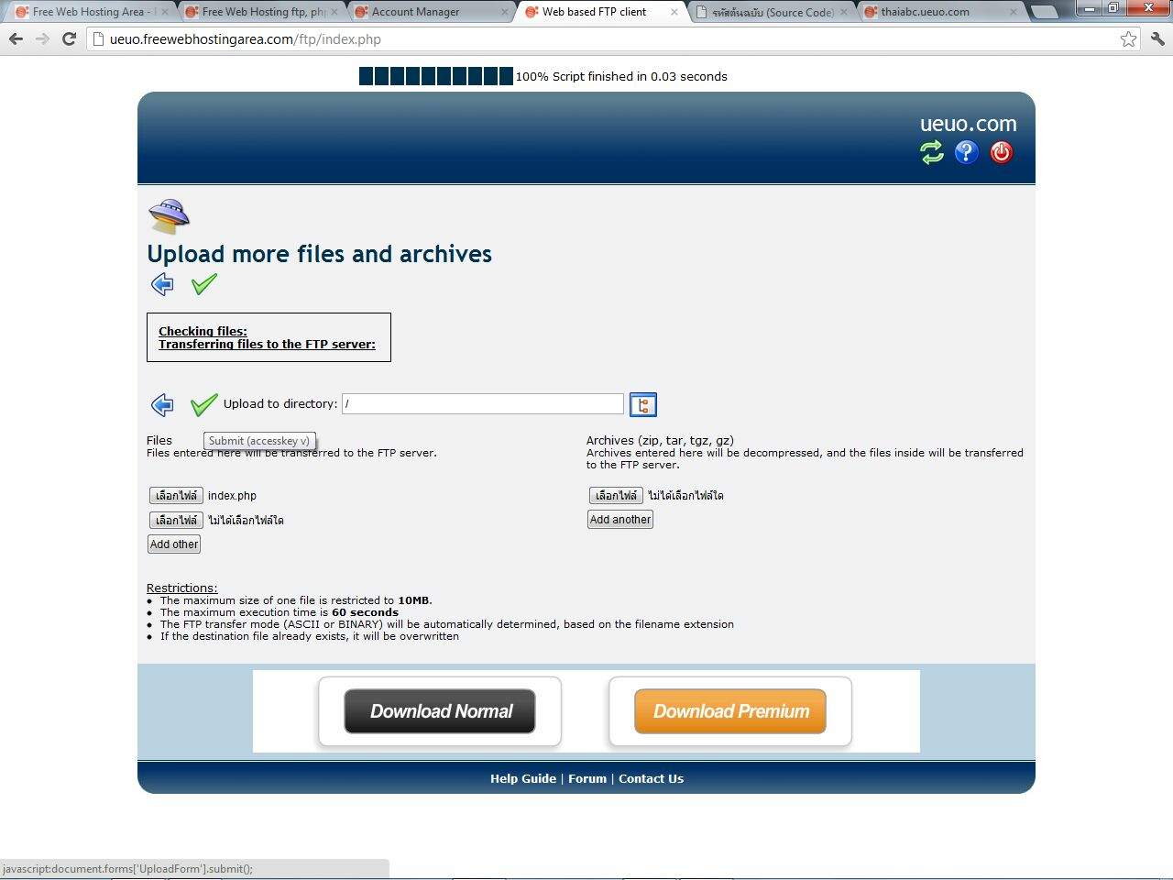
22_upload
.

Slide 24
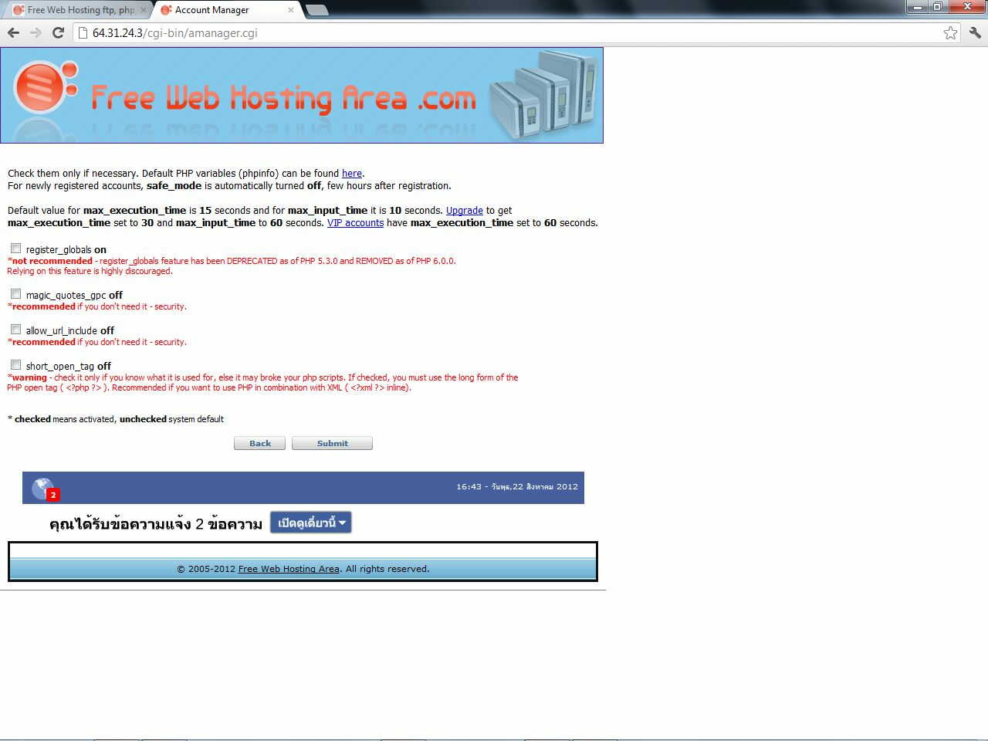
23_php_config
.

Slide 25
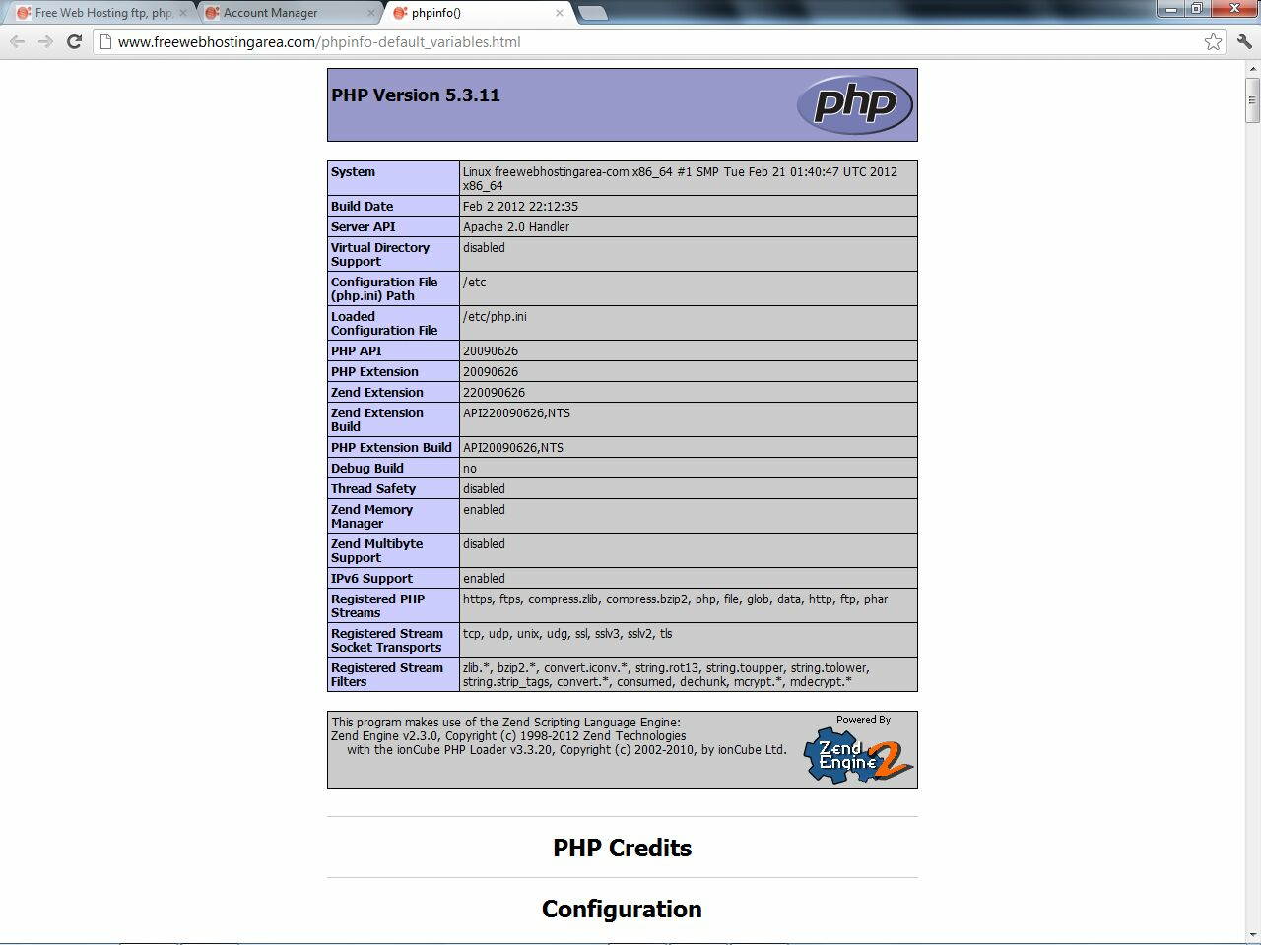
24_phpinfo
.

