Slide 1
PHP
XAMPP is webhosting for windows
- Apache : HTTPD for Web Server
- MySQL : Database Server
- PHP : Interpreter
- PHPMyAdmin
- Filezilla : FTP Server
- Mercury : Mail Server
- Tomcat : Java Server
http://www.thaiall.com/php5/xampp
Update : August 23,2012
Notes:
Reference : http://www.thaiall.com/php/training49.htm

Slide 2
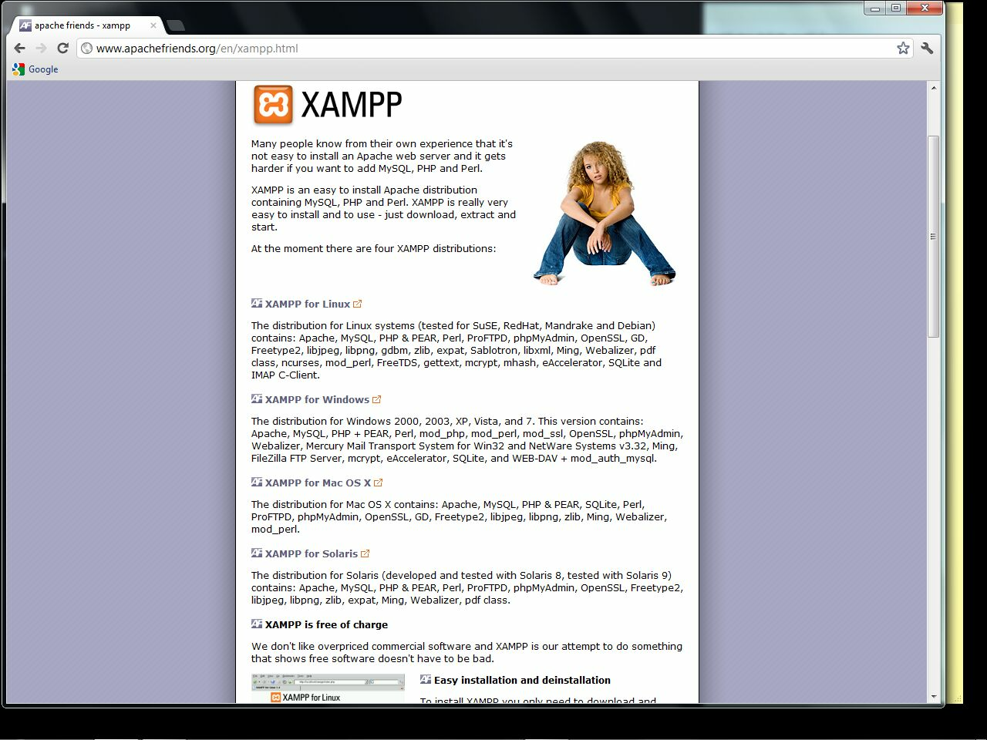
01_xampp_website
.

Slide 3
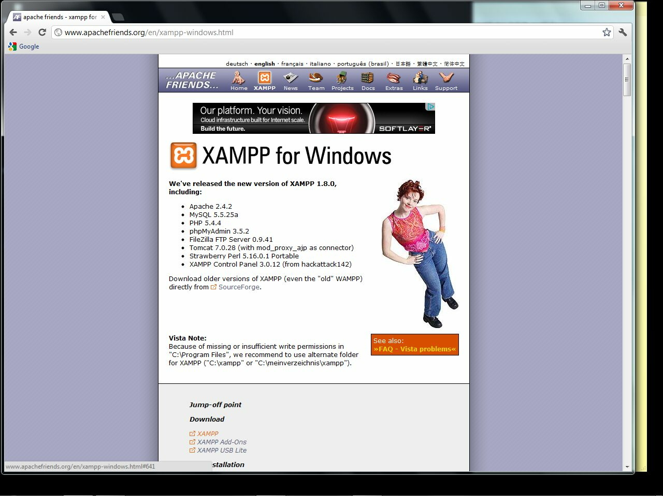
02_xampp_for_windows
.

Slide 4
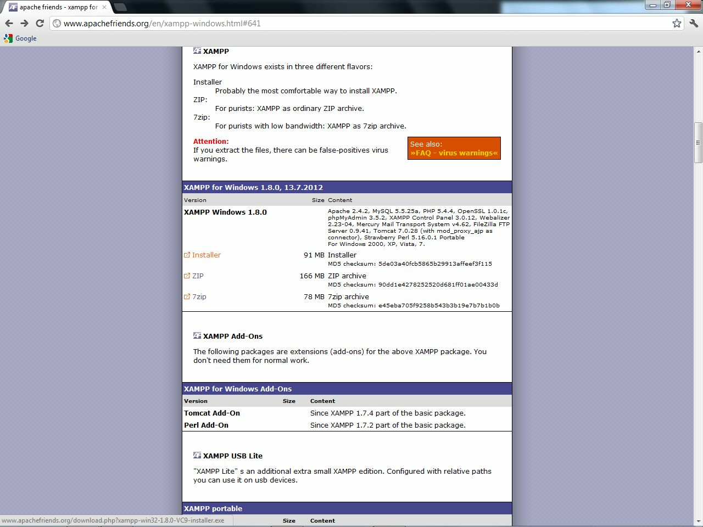
03_download_installer_1.8.0
.

Slide 5
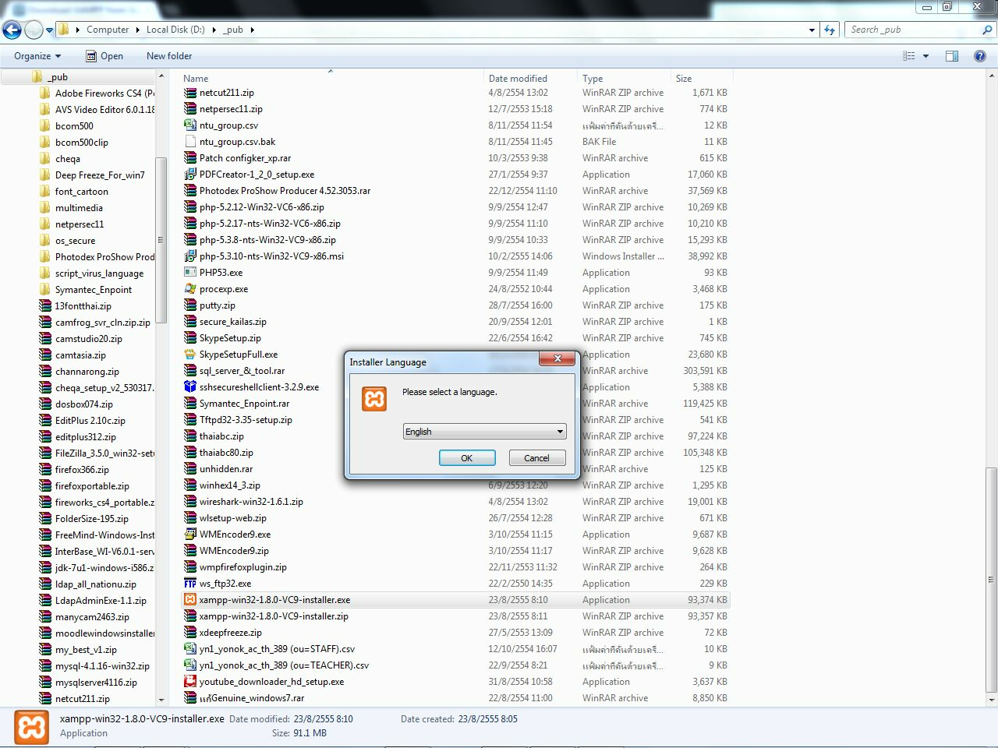
04_install
.

Slide 6
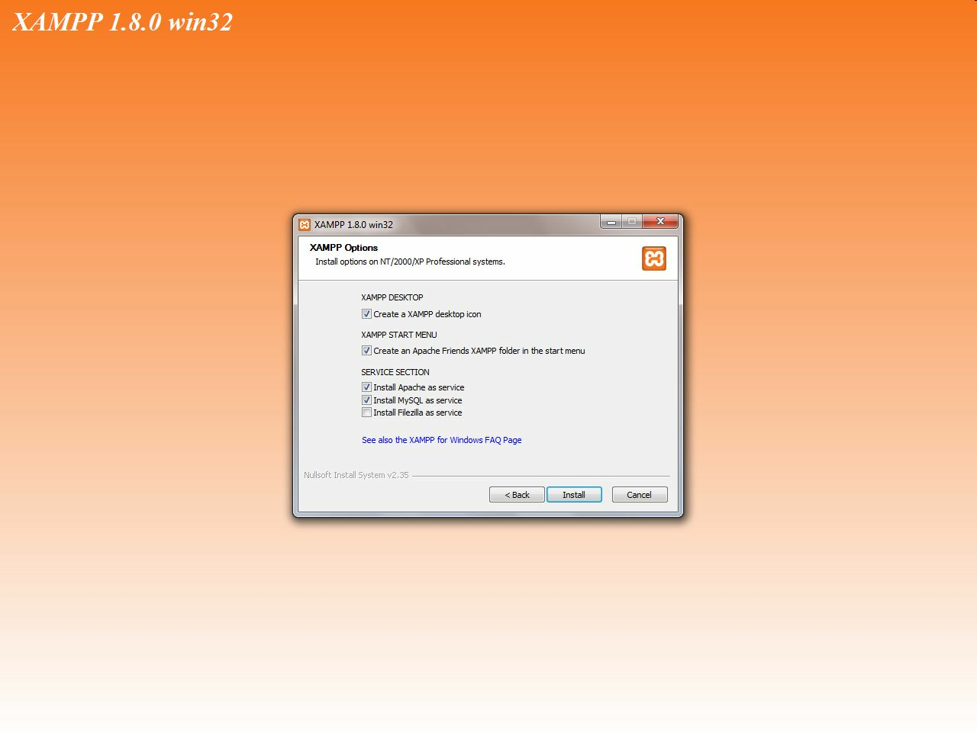
05_select_apache_mysql
.

Slide 7
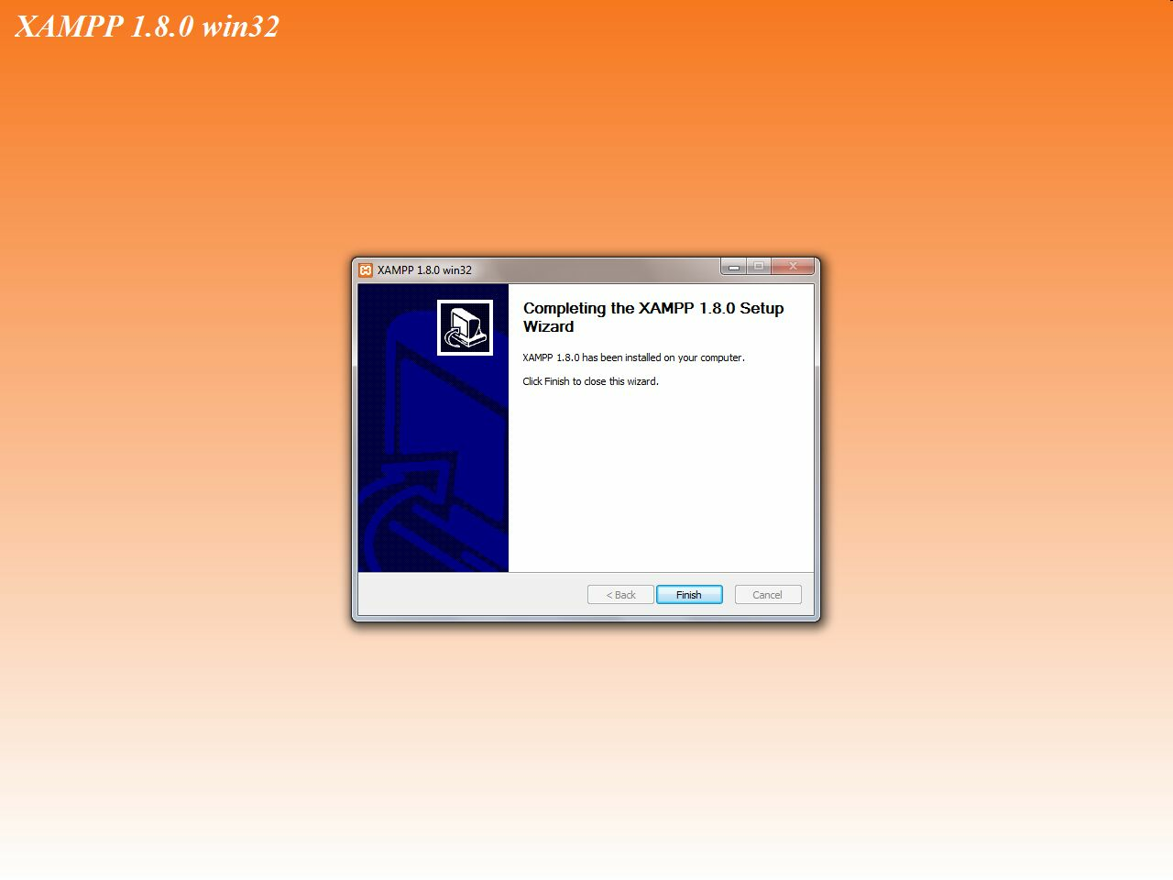
06_install_finish
.

Slide 8
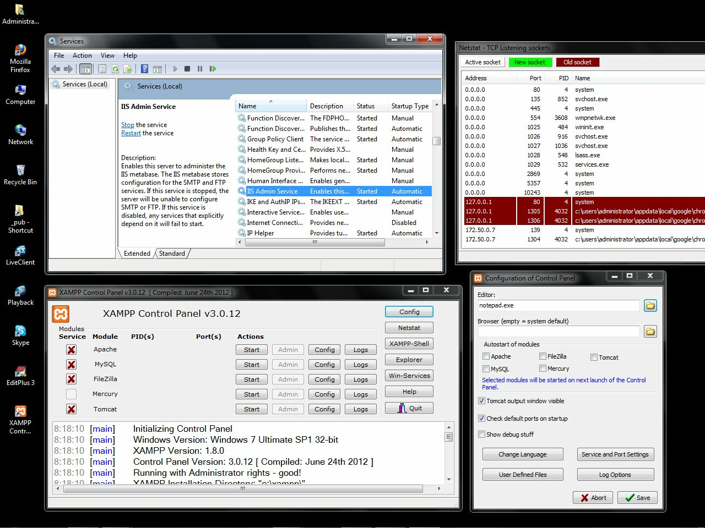
07_control_panel
.

Slide 9
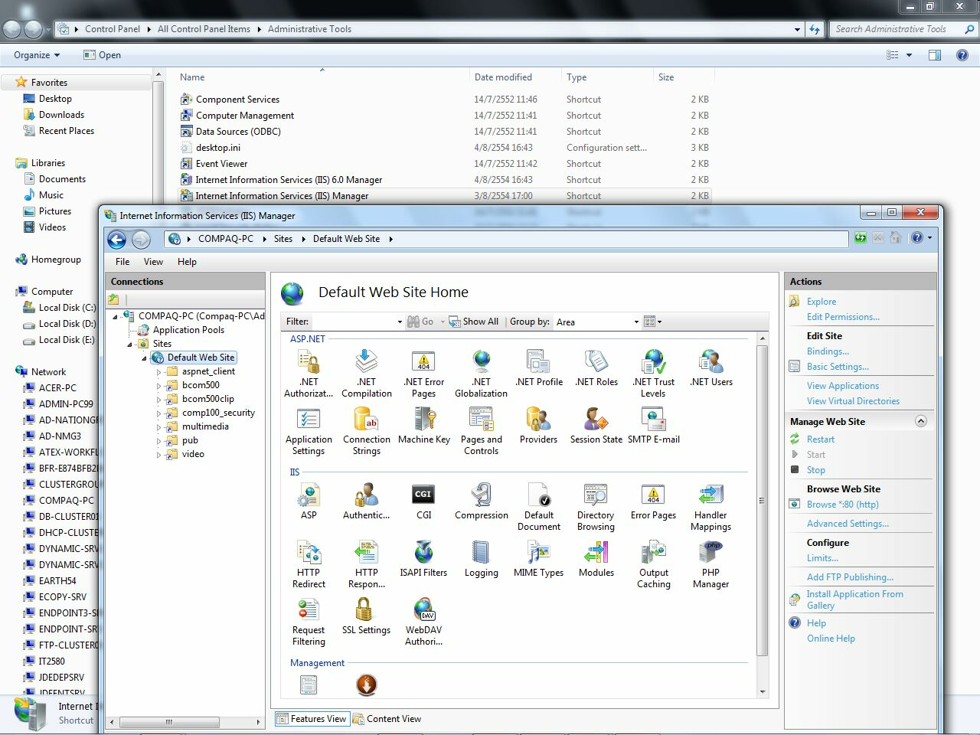
08_iis_stop
.

Slide 10
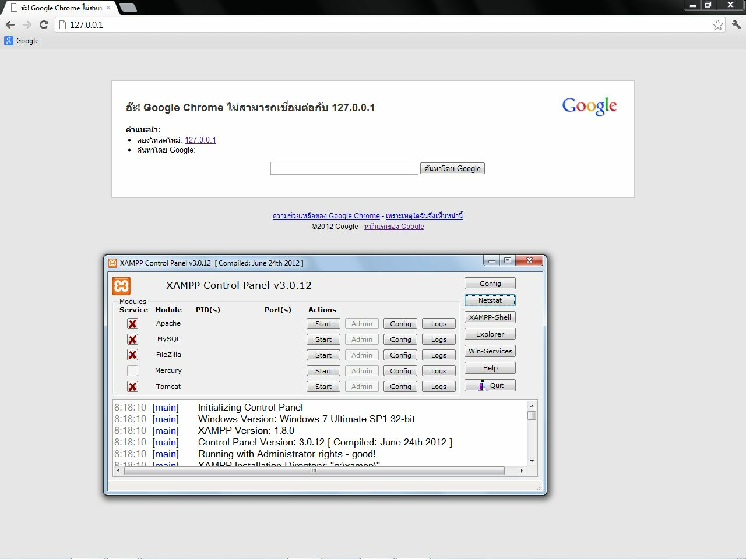
09_no_httpd_service
.

Slide 11
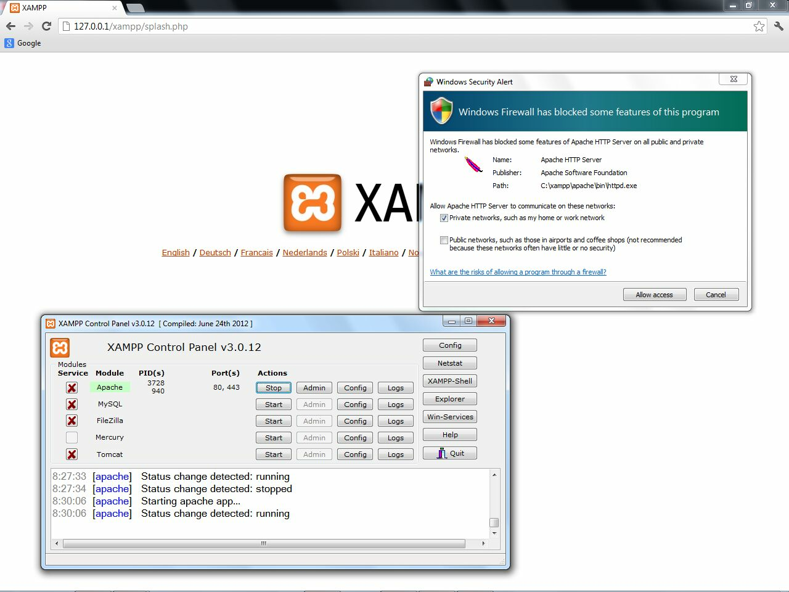
10_start_apache
.

Slide 12
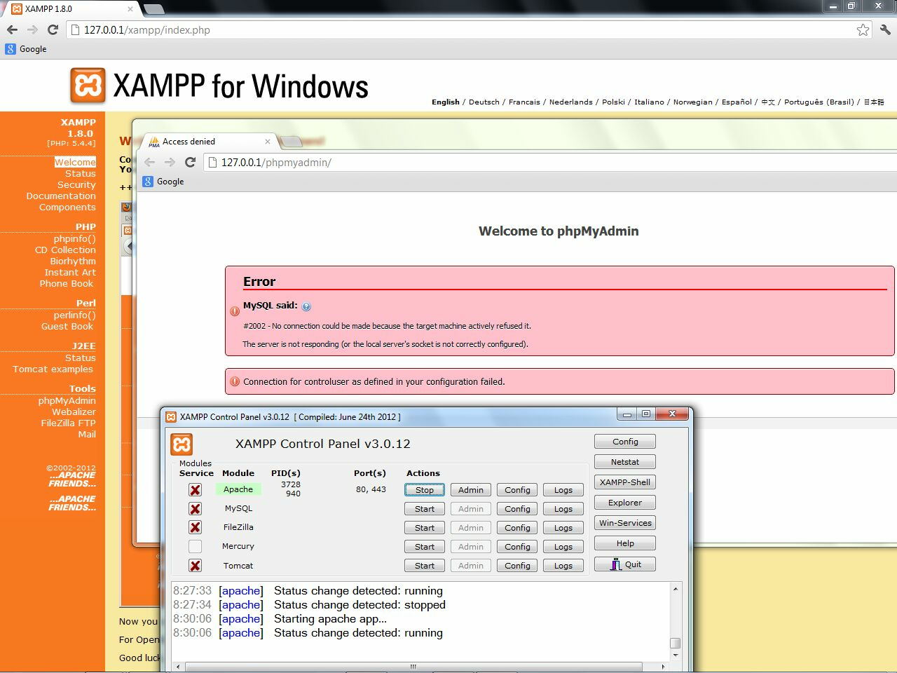
11_no_mysql
.

Slide 13
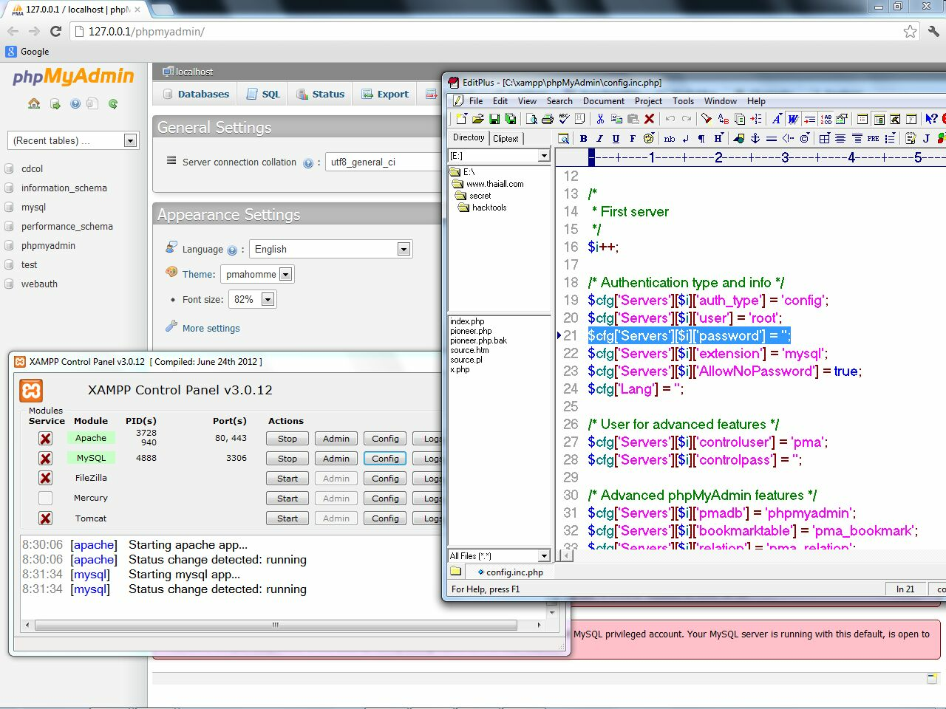
12_mysql_no_password
.

Slide 14
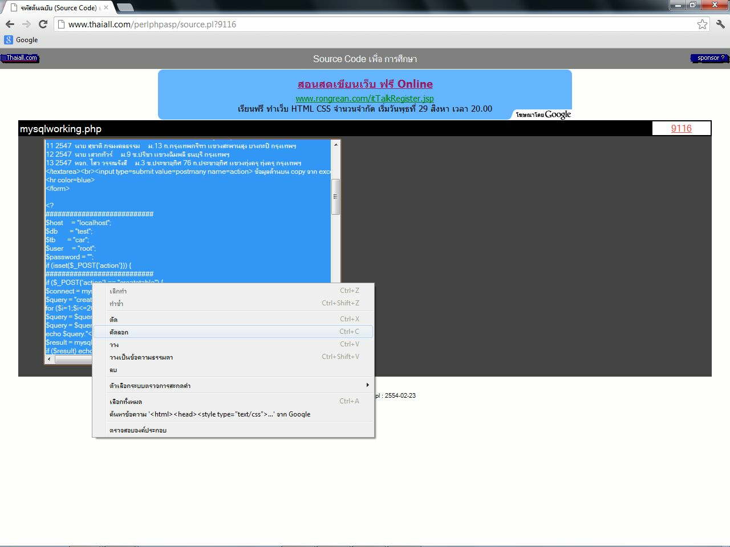
13_9116
.

Slide 15
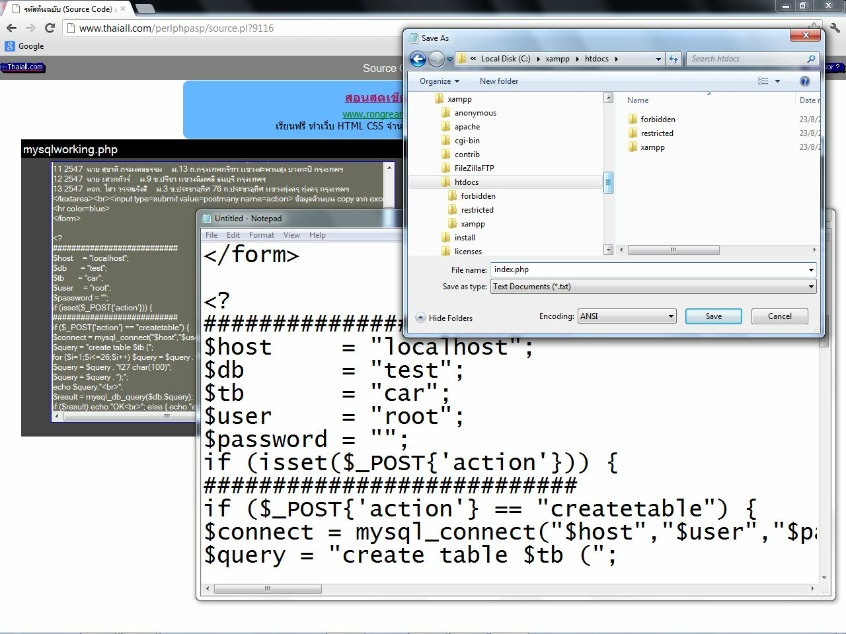
14_htdocs_index
.

Slide 16
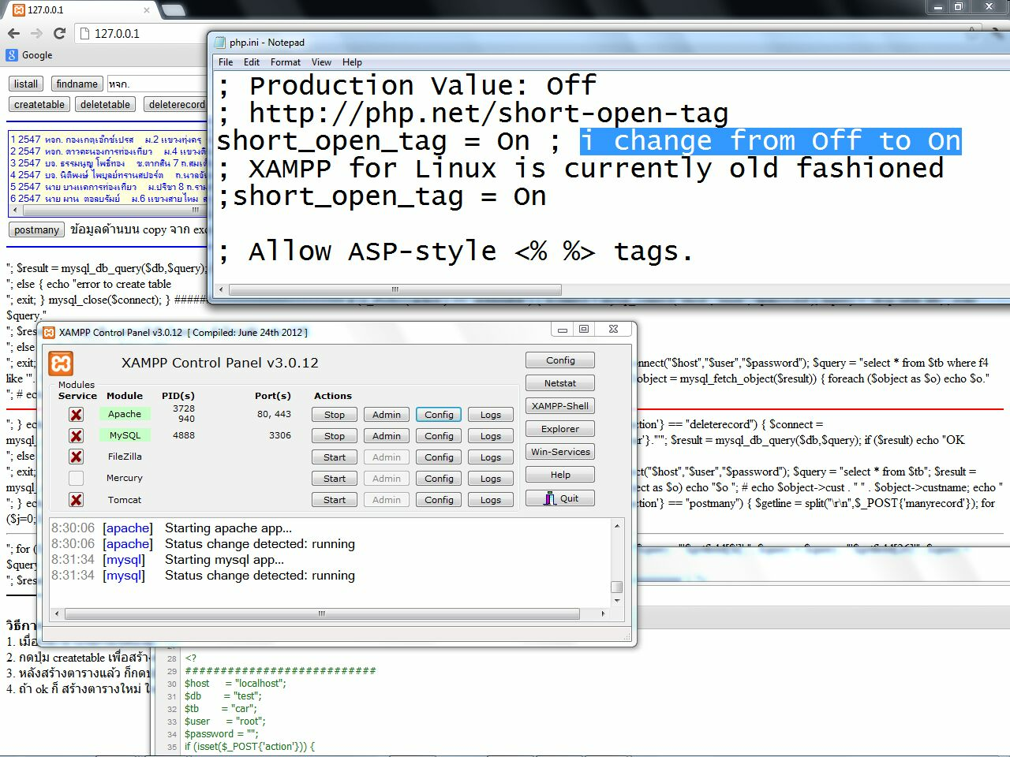
15_short_open_tag_in_php_ini
.

Slide 17
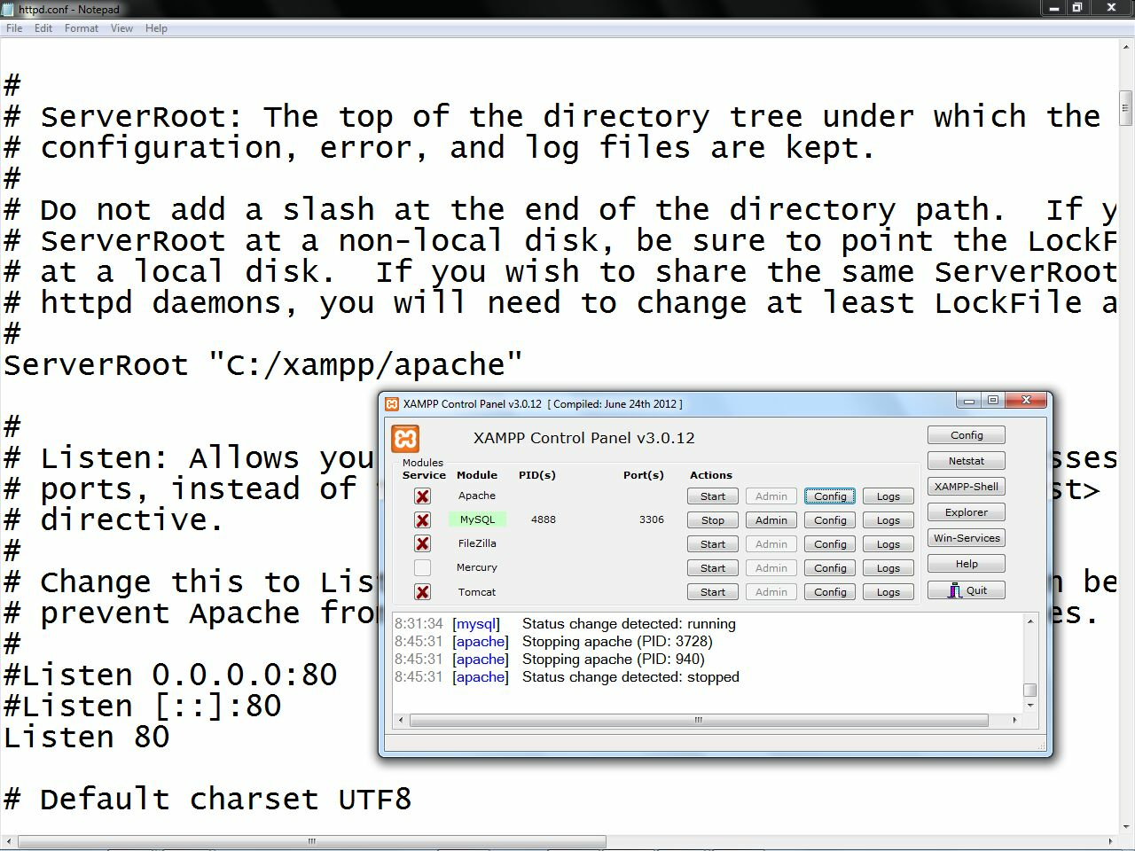
16_restart_apache
.

Slide 18
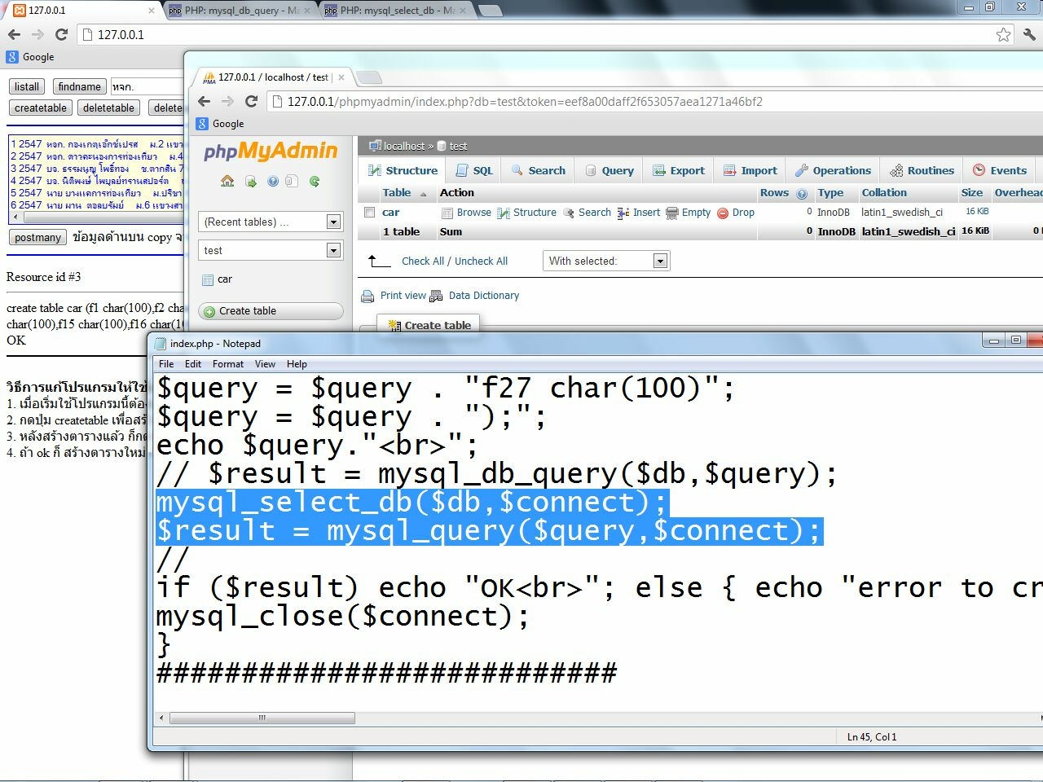
17_mysql_query
.

Slide 19
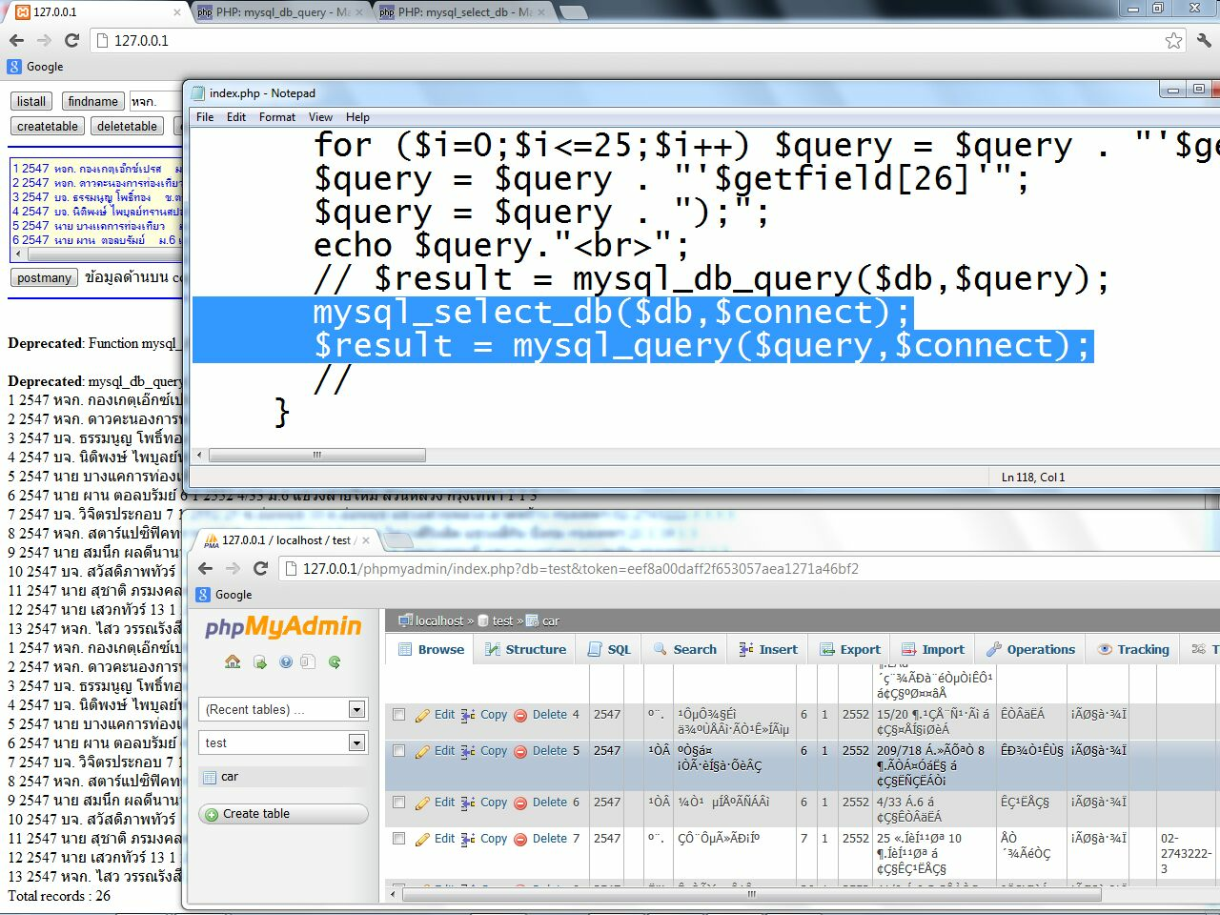
18_phpmyadmin
.

Slide 20
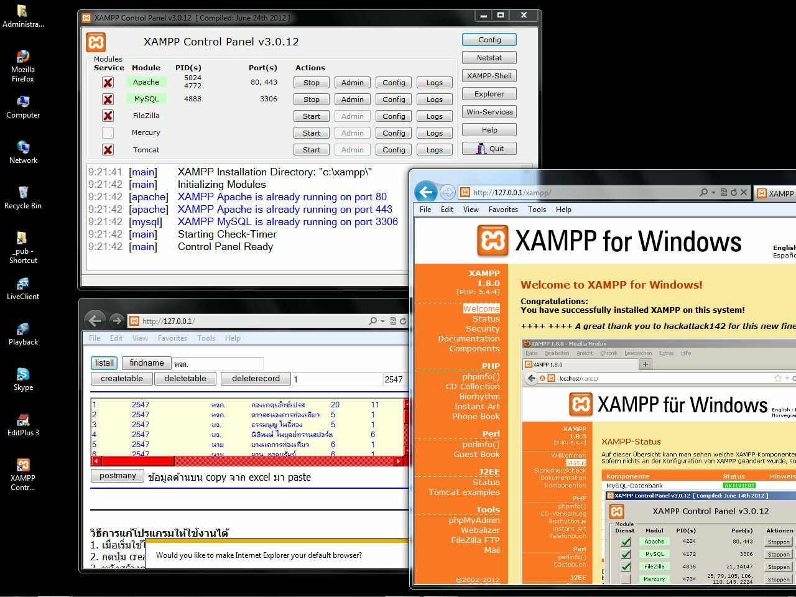
19_desktop
.

